Slide 1
Advanced Automation
Please sit with your assessment teams for this class!
Intelligent Automation Team Workshop 2
Adv. Advisory | ACCTG 528
MPAcc Class of 2025

Slide 2
Agenda
Review
Intelligent Automation Team Challenge Requirements
Suggestions and further help
Admin:
Presentation Times.
Grading update and other admin.
Team Workshop.

Slide 3
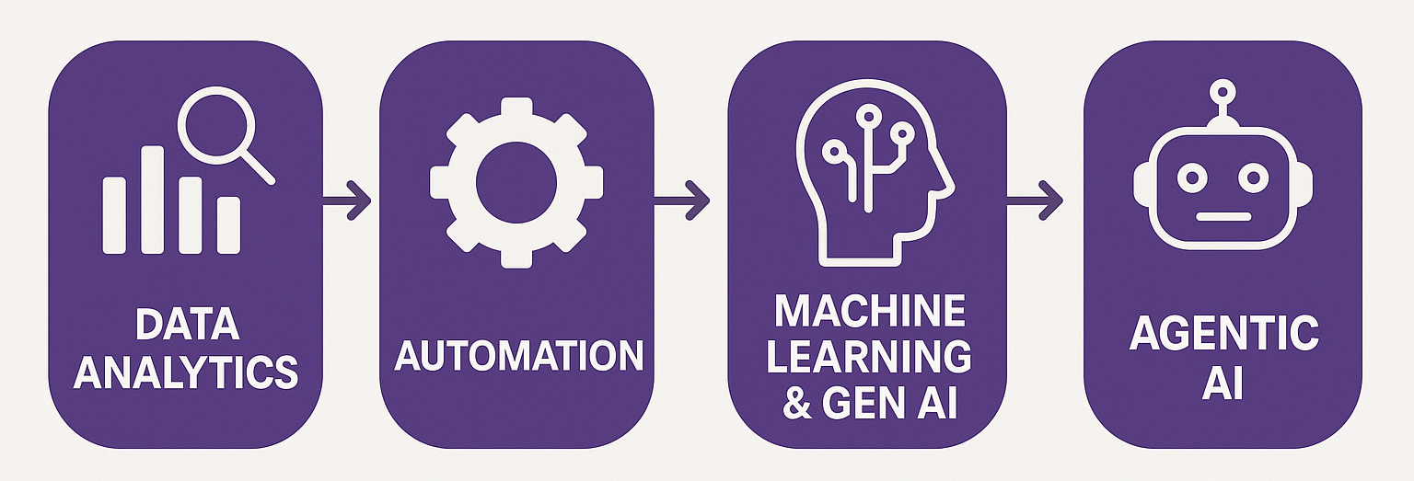
Course Overview

Slide 4
Gen AI (LLM) as an Agent

Slide 5
Intelligent Automation Team Challenge (35%)
Required deliverable: A software submission demonstrating an enterprise-oriented automation that applies at least one form of intelligent automation, including either Generative AI or Agentic AI principles:
The automation should simulate or address a real enterprise-level reporting problem. This can include financial reporting, compliance monitoring, ESG-related disclosures, or operational dashboards.
The automation must be submitted as a working prototype, capable of running on a single desktop (new: or on the cloud). It is not expected to be connected to live enterprise systems but should demonstrate the technical logic and structure of the end solution.
Teams must document which elements involve intelligent automation, especially where GenAI or agentic workflows (e.g., AI planning or multi-agent cooperation) are used.

Slide 6
Intelligent Automation Team Challenge (35%)
Required deliverable: A short presentation explaining the problem, your automation architecture, the intelligent features included, and limitations or next steps.
The presentation should include a clear process diagram showing the current manual process and how the automation addresses each step (new: you can use Maestro).
Present the automation goal, inputs, outputs, and how intelligent elements (e.g., GenAI, agentic coordination, contextual adaptation) are integrated.
Discuss limitations of your solution (e.g., data availability, LLM stability, scalability) and identify which parts are working, simulated, or proposed.

Slide 7
Intelligent Automation Team Challenge (35%)
Presentation length: 1 min set up, 7-9 mins presenting, 3-5 mins Q&A, 1 min change overs.
Audience: Just me as a project supervisor.
Demo: Not required but very strongly suggested.
Bot Governance: Each team will get at least one question relating to how you will build governance into the next iteration of the bot.
Multi-Agent versus single agent: Multi-agent is not required, in most cases if a multi-agent set-up makes sense, teams will be rewarded for it (example comparison on next slides).
Technical material: Relative to the common final, there will be more focus on the discussion of technical elements and the automation solution is part of the grade.

Slide 8
Last class: email to LLM example
What other LLM agents do you want to be able to build?
What other triggers are useful?

Slide 9
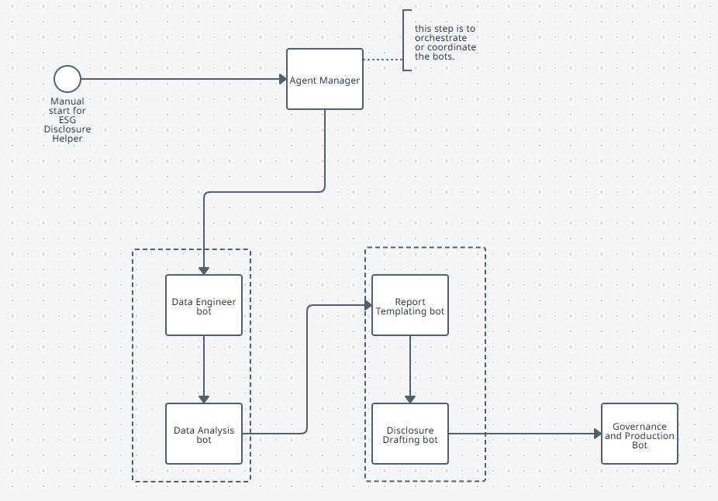
Communication steps:
Natural language to prompts
Reporting steps
Data Steps

Slide 10
Agenda
Review
Intelligent Automation Team Challenge Requirements
Suggestions and further help
Admin:
Presentation Times.
Grading update and other admin.
Team Workshop.

Slide 11
Presentation times (also on website)
Tuesday | 27th May |  | Thursday | 29th May
HON | 1:30 |  | WMT/LCID | 1:30
Kroger (KR) | 1:45 |  | FDX | 1:45
Home Depot | 2:00 |  | LMT | 2:00
UPS | 2:15 |  | Target | 2:15
RIVN | 2:30 |  | TSN | 2:30
Hess Corp (HES) | 2:45
**Late submissions need to be in Canvas no later than 1:29PM on 27th May.

Slide 12
Grading update
Individual bots: will be graded before Monday, May 26th.
Intelligent Automation Challenge: will be posted by next Friday, 30th May.
Professionalism: Don’t forget the additional assignments, will be finalized soon after May 29th.
Common Final Project: Automation Solution should be discussed (even if you don’t get your solution as far along as you’d like to), demo is optional, consider your time constraints. ACCTG 528 grades will be focused on discussion and integration with the other material, less on the technical.
Grade Ranges: (typically) 85% (3.0) to 100% (4.0), anticipated median 88% (3.3) to 90% (3.5)

Slide 13
Other Admin: Additional Resources
EYARC Experience Platform: https://experience.eyarc.site/
Gandalf Gen AI Security Challenge: https://gandalf.lakera.ai/baseline

Slide 14
Agenda
Review
Intelligent Automation Team Challenge Requirements
Suggestions and further help
Admin:
Presentation Times.
Grading update and other admin.
Team Workshop.

Slide 15
Check ins
Each team is required to check in with me.
Let me know what support I can provide remotely (video demos of activities).
I will prioritize based on number of requests.

Slide 16
Thank you

