Slide 1
Introduction to Robotic Process Automation (RPA)
Order-to-Cash Process Case Review & Conclusion
Adv. Advisory | ACCTG 528
MPAcc Class of 2025

Slide 2
Agenda
Review
PollEverywhere Q&A
Pure Reformed Oils Case: Concluded
Possible extensions
Individual RPA Challenge
Workshop / UIPath help

Slide 3
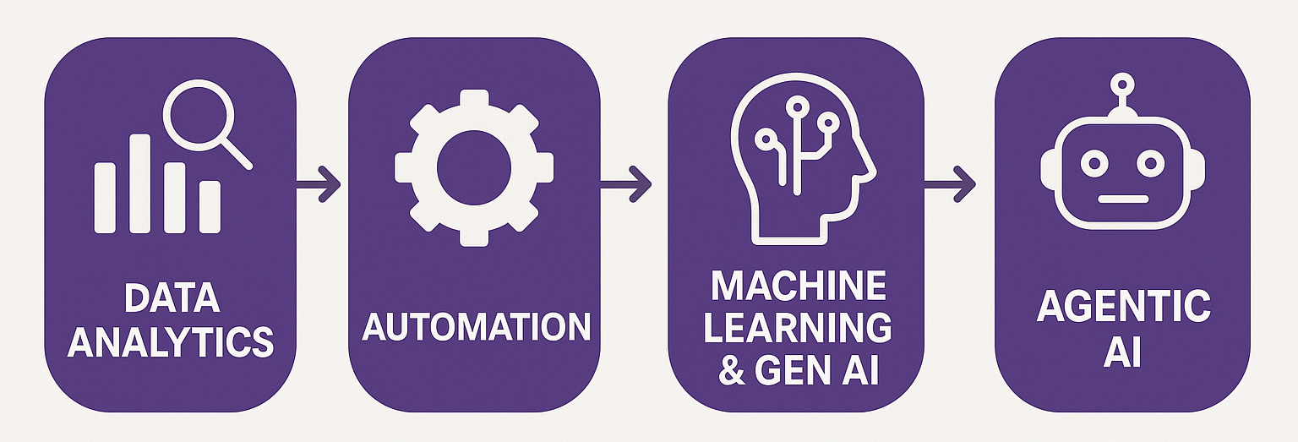
Course Overview
Order-to-Cash Process Automation
UIPath Activities
Generalizing to any spreadsheet automation

Slide 4
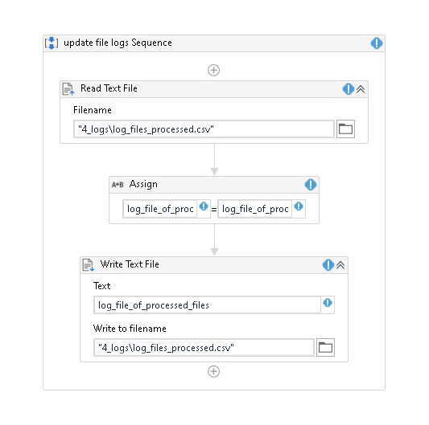
Q1: Use the image below to answer the following question:

Slide 5
Q2: Use the image below to answer the following question:

Slide 6
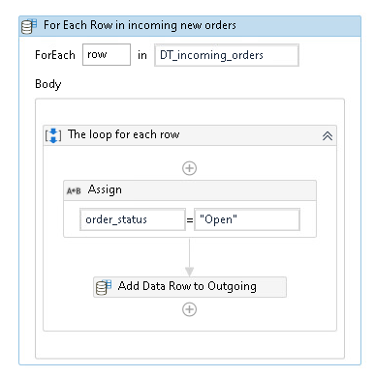
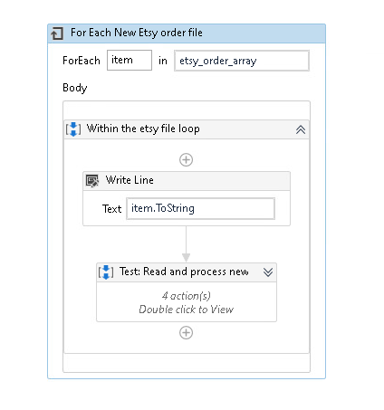
Q3: Use the images below to answer the following question:
A
B

Slide 7
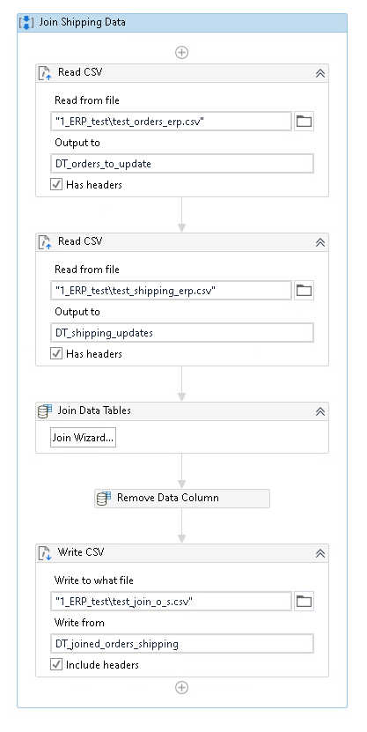
Q4: Use the image to answer the following question:

Slide 8
Q5: Use the image below to answer the following question:

Slide 9
Q6: Use the image below to answer the following question:

Slide 10
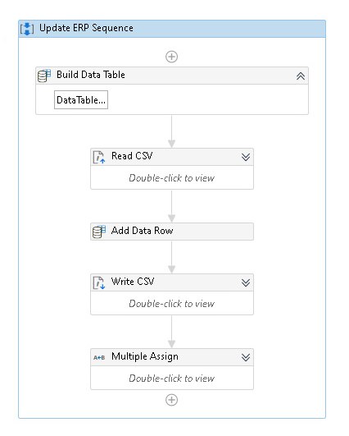
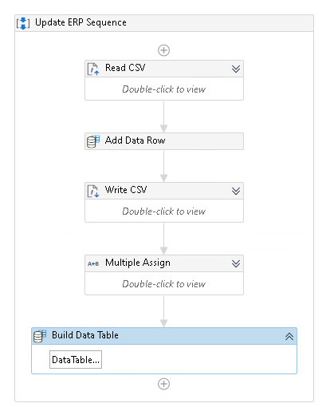
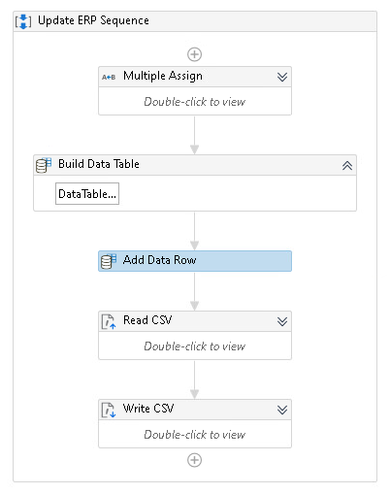
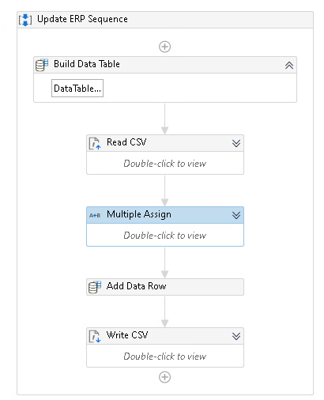
Q7: Select from the workflow images below to answer the following question:
A
B
C
D

Slide 11
Agenda
Review
PollEverywhere Q&A
Pure Reformed Oils Case: Concluded
Possible extensions
Individual RPA Challenge
Workshop / UIPath help

Slide 12
Possible extensions
Create a bot that automates the order-to-cash workflow described by the clients:
Move processed files automatically
Update ERP for shipments/deliveries
Update Inventory levels
Create metadata tags, extend the logger (with a json output)
Create diagnostic output for a dashboard / create dashboard
Other ideas:
ETSY Payments updates
Accounting system
Auto reconciliations, controls
And anything else you think could be automated / improved.

Slide 13
Possible extensions – suggestions & hints
Remember the video should include inputs & outputs and preferably the bot running.
Hint: show the output log in the video.
Make it very clear what your extension(s) is(are) in the video.
Hint: if you go beyond my list, make it clear, and if you do consider researching “end-to-end” automation and discussing your bot/solution using this language.
Discuss the solution in terms of efficiency (hours saved) and effectiveness (minimization of potential human errors, typos, mis pasting of data, etc).
Hint: Consider talking about other uses of time for Victoria and Skylar.
Hint: Another discussion point is the provision of follow up services, including maintenance and or help with other automations. You are welcome to discuss these hypotheticals.

Slide 14
Agenda
Review
PollEverywhere Q&A
Pure Reformed Oils Case: Concluded
Possible extensions
Individual RPA Challenge
Workshop / UIPath help

Slide 15
What can I automate?
Answer: Any repetitive process
Does it have to be spreadsheets only? No, it can use any type of data.
Can I automate software other than excel/csv files? Yes – these are often more impactful submissions.
Can I build off the Skylar case? Yes (for the video version), if you extend or alter it in a significant way, but note this will limit what you can do relative to the order-to-cash process. (same for the original version, but use the new data as a starting point).
Can I submit one of the legacy bots? Yes, if you extend or alter it in a significant way.
Can I start from scratch using a completely new process? Yes!

Slide 16
Bot Requirements
Required deliverable: A software deliverable of a desktop-automation level automation bot using UIPath or another automation software.
Each individual will be asked to develop a desktop-automation level automation robot of a common repetitive business task. The bot is to be built using either UIPath or the Microsoft Power Apps (or another automation software with approval from your instructor).
The RPA solution is expected to work on a single desktop, and any issues related to the transfer of the bot need to be identified and discussed.
Any files or other materials required in order to have the bot run (in most cases you will upload a zip file with your input, app, and output folders.

Slide 17
Suggestions & hints
Choose a task that is rule-based, repetitive, and ideally takes at most 5 minutes per execution – this helps demonstrate meaningful efficiency gains.
As a base case, a loop should include 3 items to loop through each case to demonstrate that the bot could loop through any number of iterations (three is plenty).
You can generate the data input into the automation and if you need help generating data, please ask.
Keep your folder structure clean and include a brief README file if additional setup is required for your bot to run (note this is uncommon, ask if unsure).
If your bot requires specific file paths, applications, or screen resolutions, note these explicitly and suggest how they could be standardized for transferability (again this should be uncommon, ask if unsure).

Slide 18
Resources
https://www.ashercurtis.me/teaching/courses/acctg528/class08.html

Slide 19
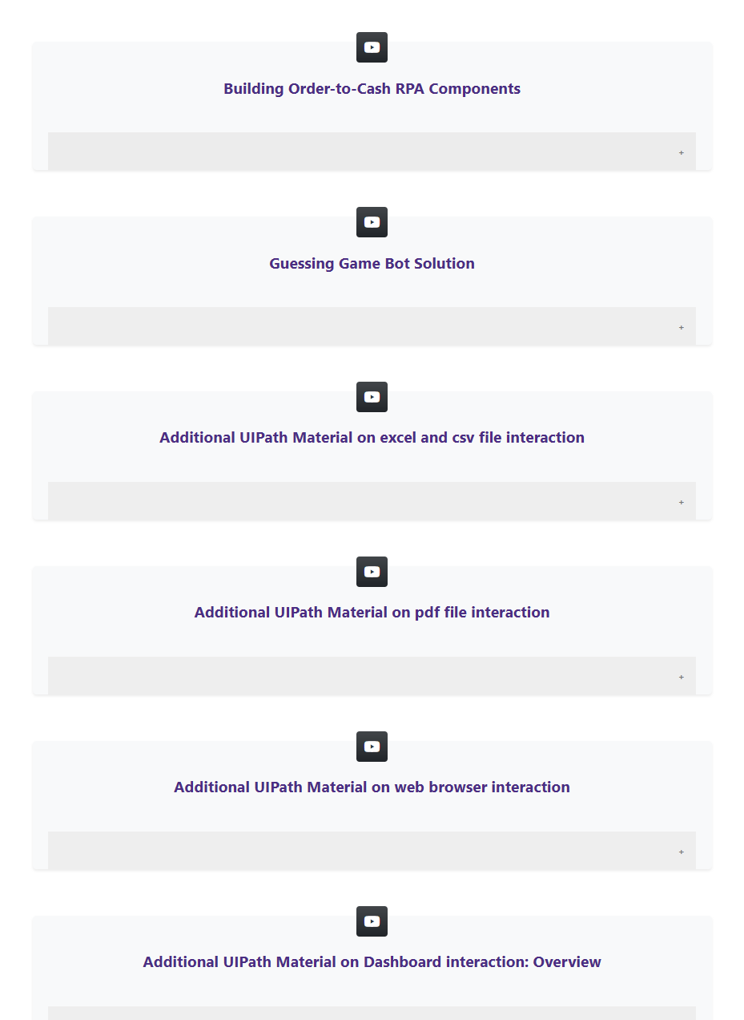
Video Resources
https://www.ashercurtis.me/teaching/courses/acctg528/videos.html

Slide 20
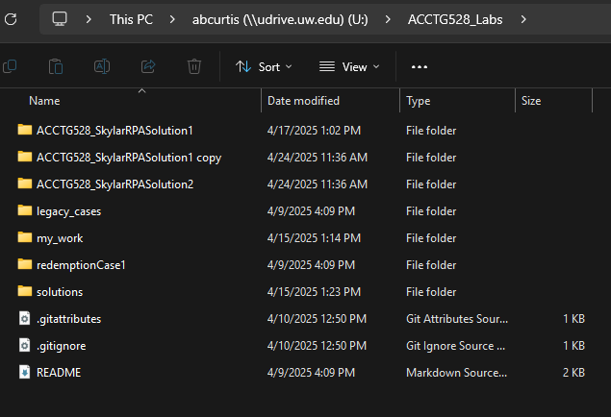
Starter files
Starter files for legacy cases
git pull

Slide 21
Agenda
Review
PollEverywhere Q&A
Pure Reformed Oils Case: Concluded
Possible extensions
Individual RPA Challenge
Workshop / UIPath help

Slide 22
Thank you

