Slide 1
Introduction to Robotic Process Automation (RPA)
Order-to-Cash Process Case Individual Workshop 2
Adv. Advisory | ACCTG 528
MPAcc Class of 2025

Slide 2
Agenda
Review
Debugging Tips and Hints
Pure Reformed Oils Case: Continued
Possible extensions

Slide 3
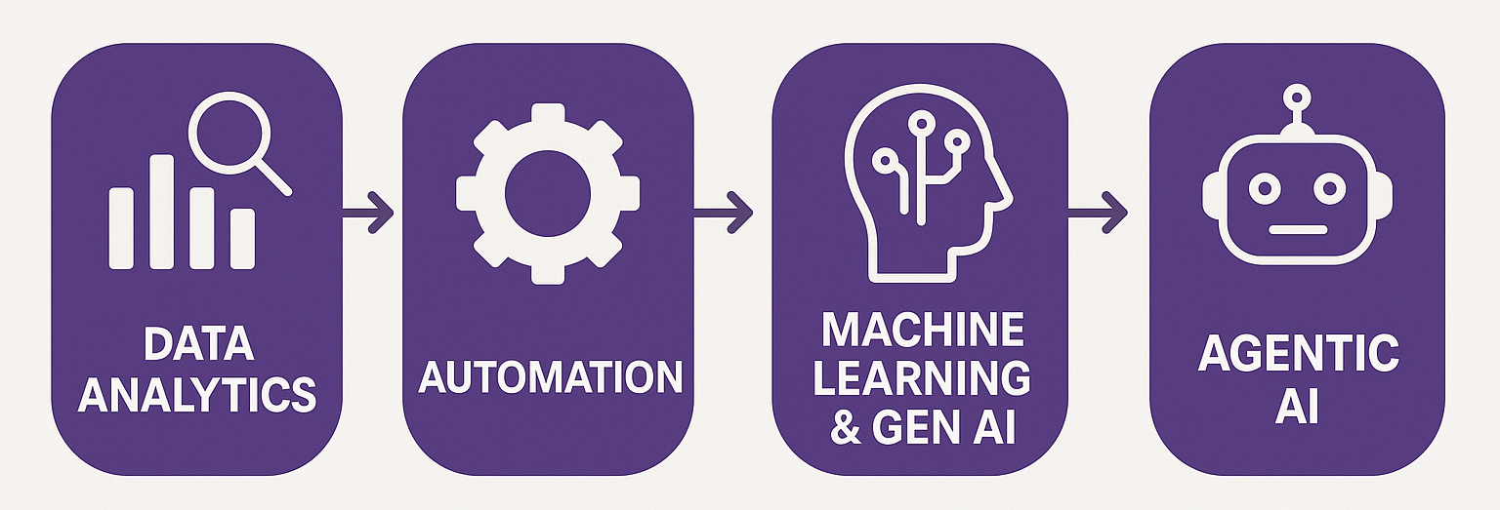
Course Overview
Order-to-Cash Process Automation
UIPath Activities
Generalizing to any spreadsheet automation

Slide 4
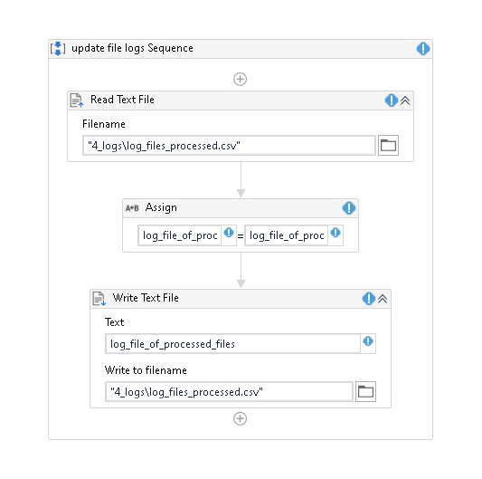
Debugging Hints and Tips
Validation error: variable is out of scope
Either not created yet, or
Created in a different scope
Fix by creating variable (CTRL+K) or increasing the scope (find where you created it)

Slide 5
Debugging Hints and Tips
Warning – variable has been defined twice
across different scope levels
Problems: may cause overwriting of data, or access of variable not expected.
Fix: Usually just delete the one with lowest scope (created by accident)
or limit the scope of the higher scope variable

Slide 6
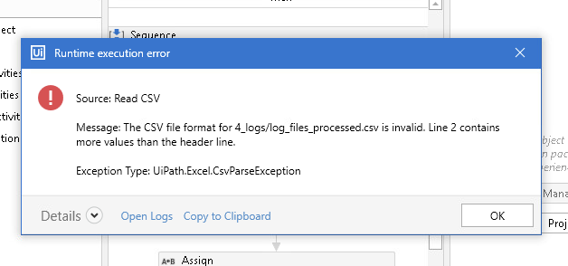
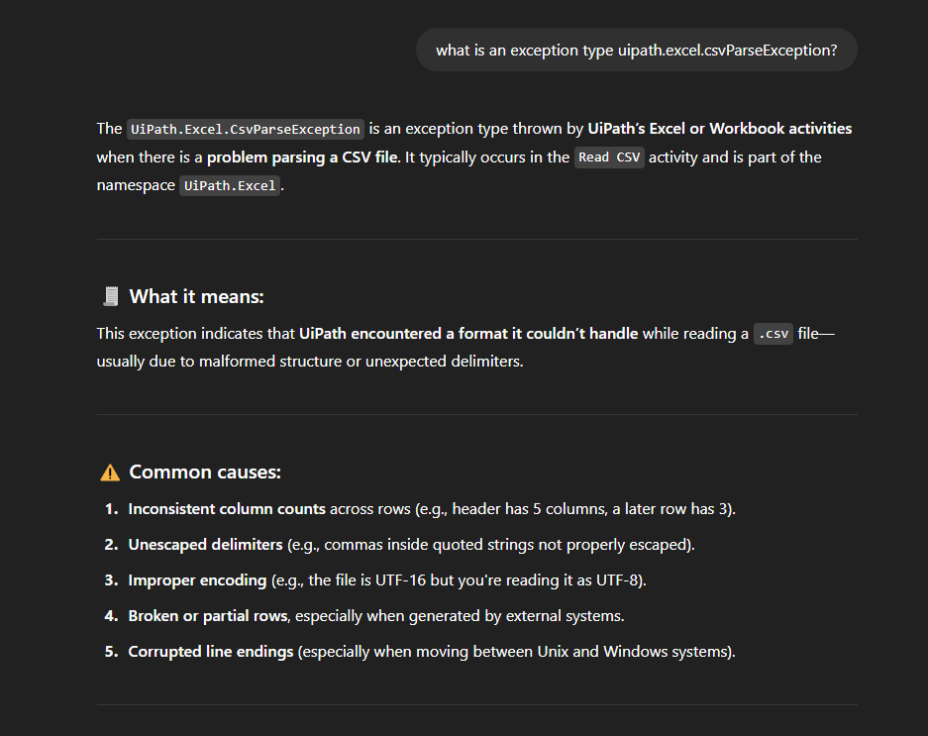
Debugging Hints and Tips
May require multiple steps,
first look for some evidence of what it relates to
Tracking down a new error
You can google/GPT the exception type

Slide 7
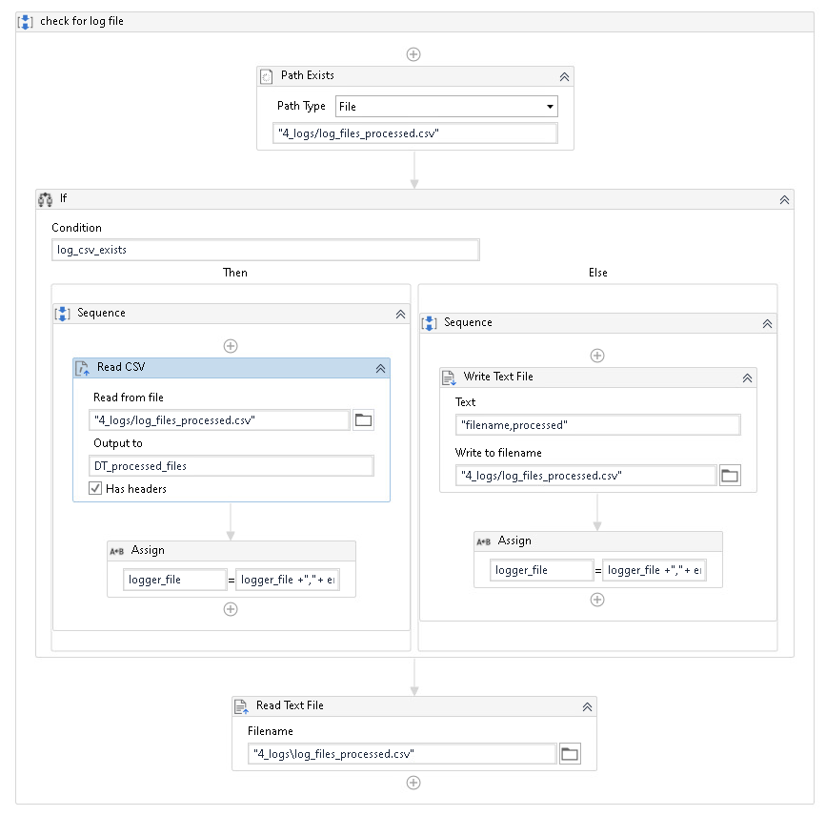
We identified it has something to do with this file
So we can retrace our steps

Slide 8
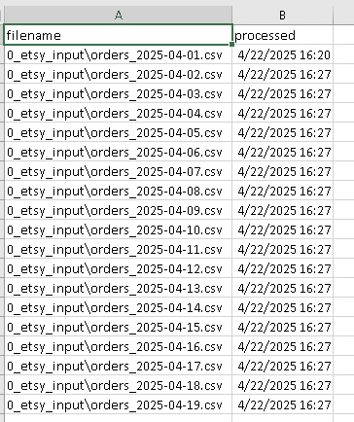
Take a look at the file, we get this but expect this

Slide 9
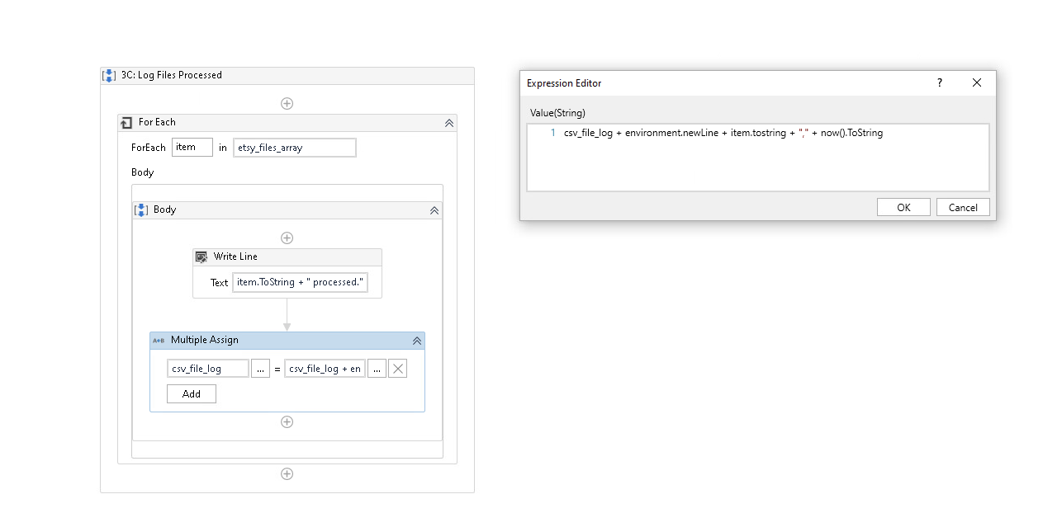
Look for times that the file might be interacted with, e.g., updates to log

Slide 10
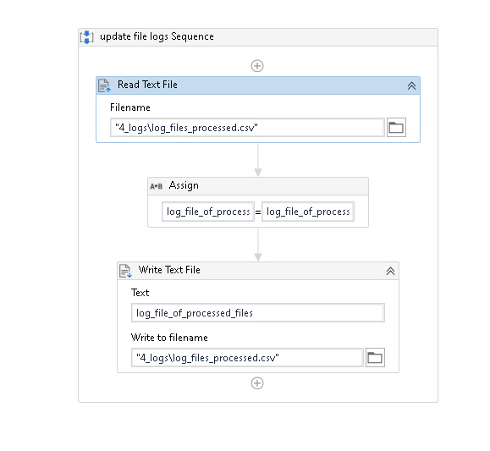
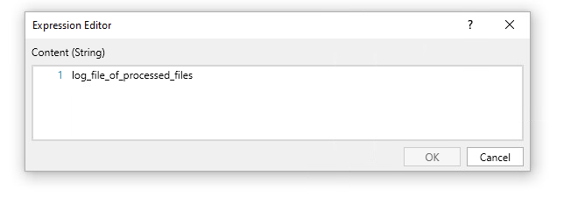
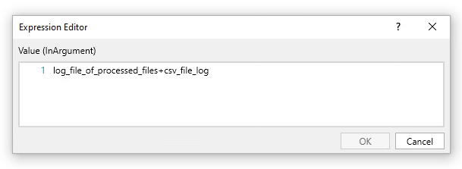
What was the problem???
It was this part

Slide 11
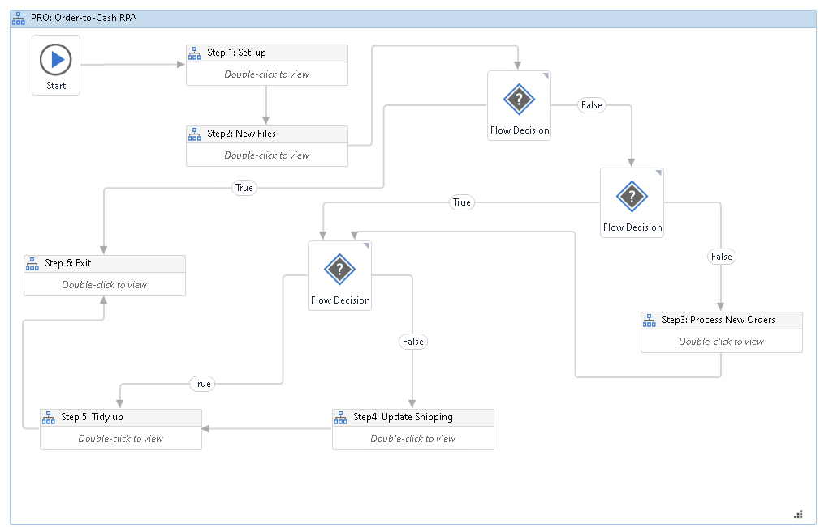

Slide 12
Agenda
Review
Debugging tips and hints
Pure Reformed Oils Case: Continued
Possible extensions

Slide 13
Possible extensions
Create a bot that automates the order-to-cash workflow described by the clients:
Move processed files automatically
Update ERP for shipments/deliveries
Update Inventory levels
Create metadata tags, extend the logger (with a json output)
Create diagnostic output for a dashboard / create dashboard
Other ideas:
ETSY Payments updates
Accounting system
Auto reconciliations, controls
And anything else you think could be automated / improved.

Slide 14
1. Move files

Slide 15
2. Update shipping and deliveries

Slide 16
3. Update inventory levels
OR
3. Update inventory levels
OR: New step 5
(step5 becomes 6, 6 becomes 7)
3. Update inventory levels

Slide 17
Inventory levels
5. Dashboard will require new steps, new calculations

Slide 18
Possible extensions - recap
Create a bot that automates the order-to-cash workflow described by the clients:
Move processed files automatically
Update ERP for shipments/deliveries
Update Inventory levels
Create metadata tags, extend the logger (with a json output)
Create diagnostic output for a dashboard / create dashboard
Other ideas:
ETSY Payments updates
Accounting system
Auto reconciliations, controls
And anything else you think could be automated / improved.

Slide 19
Possible extensions – suggestions & hints
Remember the video should include inputs & outputs and preferably the bot running.
Hint: show the output log in the video.
Make it very clear what your extension(s) is(are) in the video.
Hint: if you go beyond my list, make it clear, and if you do consider researching “end-to-end” automation and discussing your bot/solution using this language.
Discuss the solution in terms of efficiency (hours saved) and effectiveness (minimization of potential human errors, typos, mis pasting of data, etc).
Hint: Consider talking about other uses of time for Victoria and Skylar.
Hint: Another discussion point is the provision of follow up services, including maintenance and or help with other automations. You are welcome to discuss these hypotheticals.

Slide 20
Thank you

