Slide 1
Introduction to Robotic Process Automation (RPA)
Order-to-Cash Process Case Individual Workshop 1
Adv. Advisory | ACCTG 528
MPAcc Class of 2025

Slide 2
Agenda
Review
Pure Reformed Oils Case: Continued
Possible extensions

Slide 3
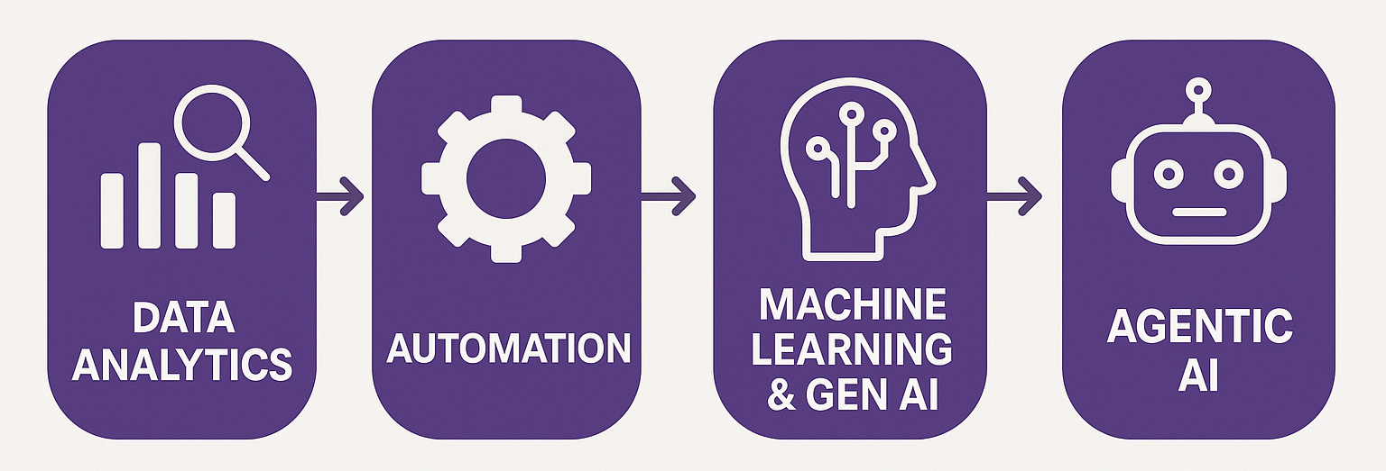
Course Overview
Order-to-Cash Process Automation
UIPath Activities
Generalizing to any spreadsheet automation

Slide 4
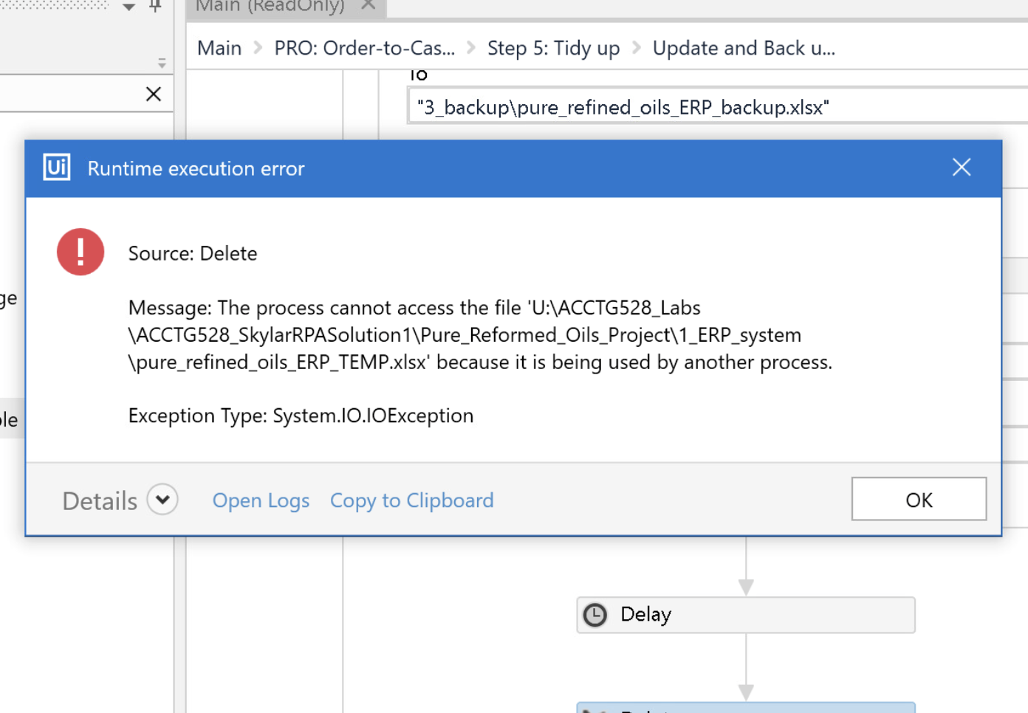
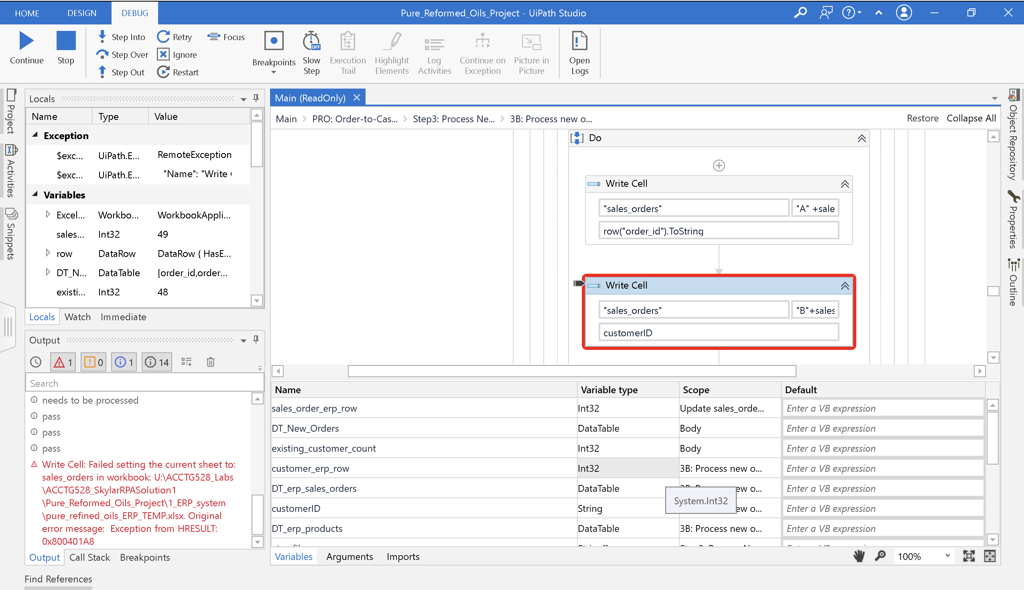
Class 6 recap
Thanks for the Write Cell Error emails (and other errors)
Good news – all errors related to Excel

Slide 5
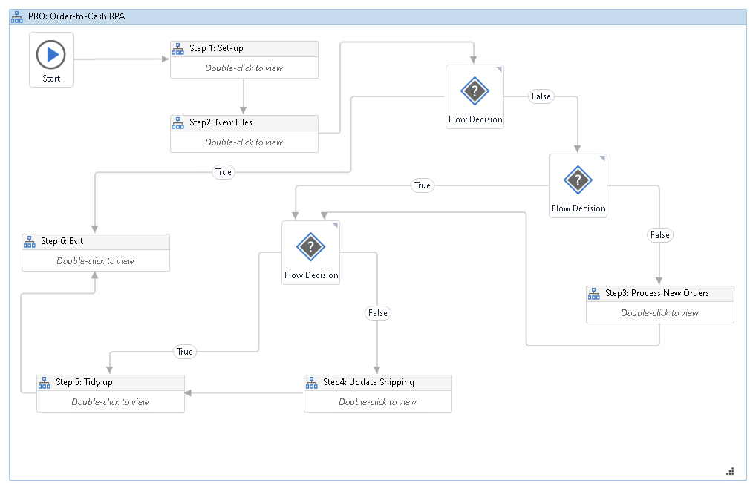

Slide 6
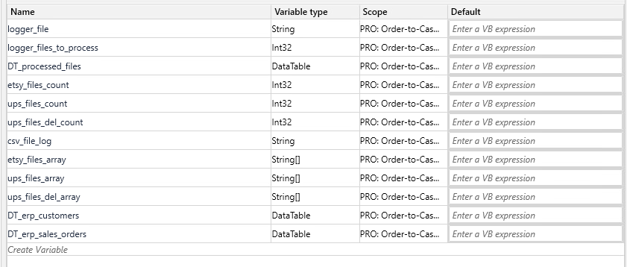
In scope at top level

Slide 7
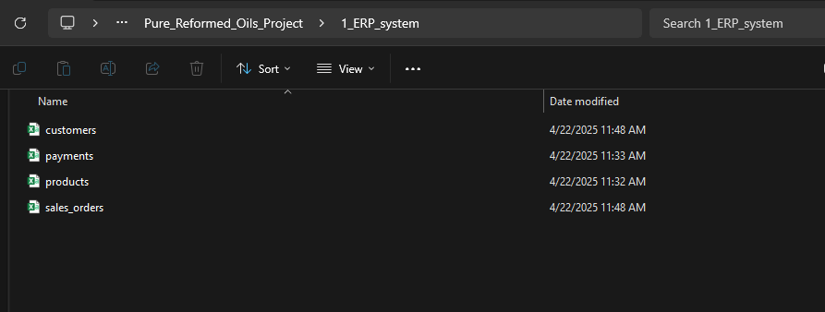
No excel version of ERP

Slide 8
Changed (removes xlsx)
Changed (removes xlsx)
Updated!

Slide 9
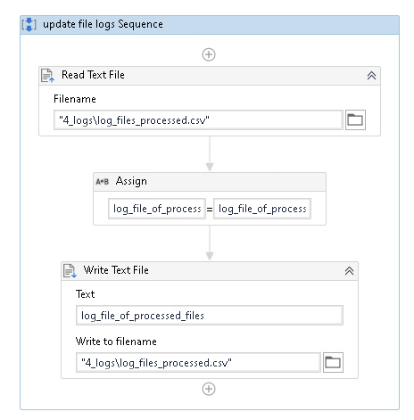
Update: Updating files processed log

Slide 10
Agenda
Review
Pure Reformed Oils Case: Continued
Possible extensions

Slide 11
Possible extensions
Create a bot that automates the order-to-cash workflow described by the clients:
Move processed files automatically
Update ERP for shipments/deliveries
Update Inventory levels
Create metadata tags, extend the logger (with a json output)
Create diagnostic output for a dashboard / create dashboard
Other ideas:
ETSY Payments updates
Accounting system
Auto reconciliations, controls
And anything else you think could be automated / improved.

Slide 12
1. Move files

Slide 13
2. Update shipping and deliveries

Slide 14
3. Update inventory levels
OR
3. Update inventory levels
OR: New step 5
(step5 becomes 6, 6 becomes 7)
3. Update inventory levels

Slide 15
Inventory levels
5. Dashboard will require new steps, new calculations

Slide 16
Possible extensions - recap
Create a bot that automates the order-to-cash workflow described by the clients:
Move processed files automatically
Update ERP for shipments/deliveries
Update Inventory levels
Create metadata tags, extend the logger (with a json output)
Create diagnostic output for a dashboard / create dashboard
Other ideas:
ETSY Payments updates
Accounting system
Auto reconciliations, controls
And anything else you think could be automated / improved.

Slide 17
Possible extensions – suggestions & hints
Remember the video should include inputs & outputs and preferably the bot running.
Hint: show the output log in the video.
Make it very clear what your extension(s) is(are) in the video.
Hint: if you go beyond my list, make it clear, and if you do consider researching “end-to-end” automation and discussing your bot/solution using this language.
Discuss the solution in terms of efficiency (hours saved) and effectiveness (minimization of potential human errors, typos, mis pasting of data, etc).
Hint: Consider talking about other uses of time for Victoria and Skylar.
Hint: Another discussion point is the provision of follow up services, including maintenance and or help with other automations. You are welcome to discuss these hypotheticals.

Slide 18
Thank you

