Slide 1
Introduction to Robotic Process Automation (RPA)
Automating the Order-to-Cash Process with RPA (Class 3/4)
Adv. Advisory | ACCTG 528
MPAcc Class of 2025

Slide 2
Agenda
Review
Pure Reformed Oils Case: Continued
Lab 1: Make a back up of ERP system choices
Lab 2: Outputting data to specific excel cells

Slide 3
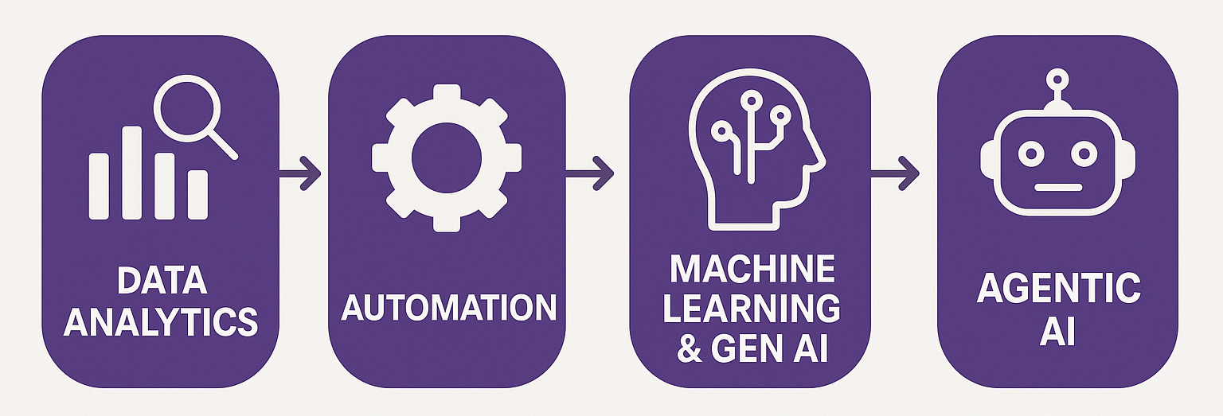
Course Overview
Order-to-Cash Process Automation
UIPath Activities
Generalizing to any spreadsheet automation

Slide 4
Agenda
Review
Pure Reformed Oils Case: Continued
Lab 1: Make a back up of ERP system choices
Lab 2: Outputting data to specific excel cells

Slide 5
Part II
Create a bot that automates the order-to-cash workflow described by the clients:
Done | Process/Task | UIPath Activities
☑️ | Read: new orders, shipping & deliveries | Read CSV
☑️ | Read: Existing data in ERP | Excel Application Scope, Read Range
☑️ | Loop through data in UIPath | For Each Row
☑️ | Output to excel | Excel Application Scope, Write Range
☑️ | Write log messages to console | Write Line

Slide 6
Part II
Create a bot that automates the order-to-cash workflow described by the clients:
Done | Process/Task
❌ | Create copies of data for backups or temporary updating
❌ | Update the ERP system with new orders
❌ | Check for existing/update new Customers
❌ | Get ProductIDs, update inventory levels
❌ | Log and save metadata for governance/process mining

Slide 7
Points to consider
Data can move in parallel:
All data is initially triggered by the order
The process is retriggered by a new order, and older orders need not be completed before staring a new one.
Data is updated by the arrival of new information (mostly shipping related)
You can suggest changes to order /combine parts of the process to make it more efficient:
This is a positive for automation.
Excel is not always the best solution, you can propose other alternatives. Excel excels at tasks that need formatting for human consumption (otherwise it is inefficient relative to storing the data as data).
Add as many steps and as much detail as you want (this is for you to prepare to build the bot, not for the client or to sell the product).

Slide 8
Task Name | Software and System(s) utilized | Prototype / Simulation for RPA Solution
Monitor for New Order | Etsy Seller Portal (online/browser) | A single CSV/JSON (input to simulated a download or API call)
Extract Order Details for shipping | Etsy Seller Portal: Order Page (online/browser) | Uses data from above
Generate Shipping Label and Send Confirmation Email | excel: Orders.xlsx and email system: e.g., Gmail | No new data, allow email to be autogenerated on ETSY; Consider skipping orders.xlsx
Update Inventory File | Excel (or Google Sheets) | Still need something here (xlsx?). Consider cheap traditional scalable storage (e.g., SQL); simulation as a CSV or Excel is fine.
Prints and ships physical product | Etsy / USPS API | Skylar manual process; Consider new data as CSV/JSON input with outbound shipping confirmation
Mark Order as Shipped in systems | Etsy Dashboard and excel: shipping.xlxs | As above
Initial Post to Accounting System | QuickBooks (we will use Excel) | Excel (Automate JE’s from step#1)
Receive Shipping Confirmation | Gmail | csv./json
Final Post to Accounting System | QuickBooks (we will use Excel) | Excel (Automate JE’s from data – delivery confirmations)
Reconciliations | QuickBooks (we will use Excel), all local Excel Files, Etsy Dashboards | Individual discretion and creativity (see canvas assignments for details on the grading scale, professionalism up to +15)

Slide 9
Agenda
Review
Pure Reformed Oils Case: Continued
Lab 1: Make a back up of ERP system choices
Lab 2: Outputting data to specific excel cells

Slide 10
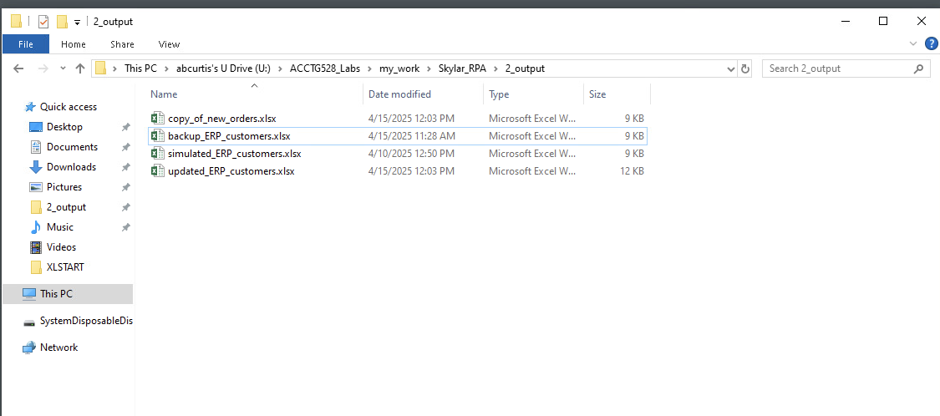
Backup as one option in case of problems/errors
Biggest Risk is overwriting/deleting data here
Working version of the file here.
Keeping relevant data and adding new data

Slide 11
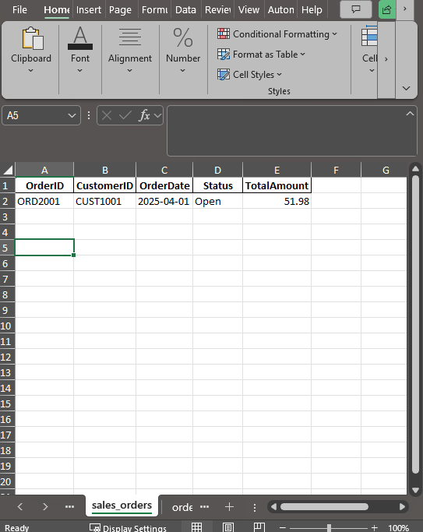
Example: Update an excel file task
?

Slide 12
Thank you

