Slide 1
Introduction to Robotic Process Automation (RPA)
Adv. Advisory | ACCTG 528
MPAcc Class of 2025

Slide 2
Agenda
Review
Pure Reformed Oils Cas: Overview
Lab Part I: Introduction and Mapping the Process

Slide 3
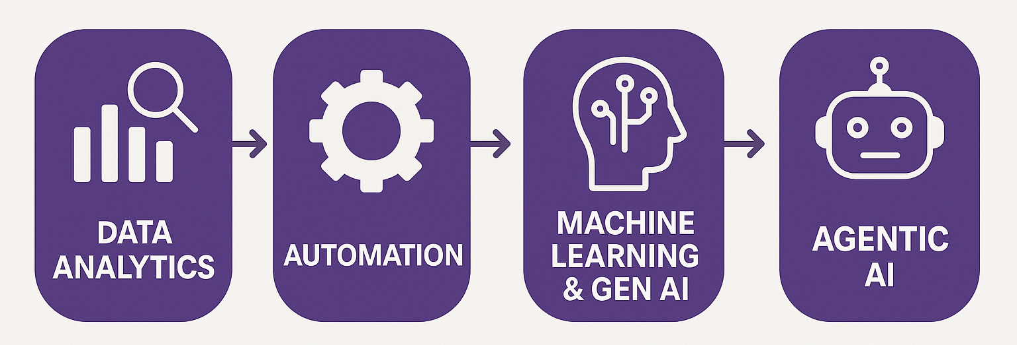
Course Overview
Clean Data
Controls
Rule-based and “Human-in-the-loop”

Slide 4
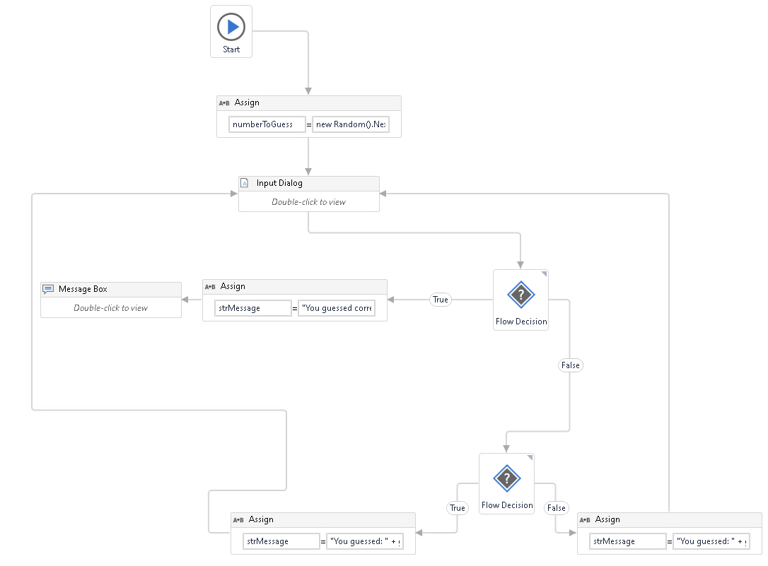
Our First Bot

Slide 5
Agenda
Review
Pure Reformed Oils Case: Overview
Lab Part I: Introduction and Mapping the Process

Slide 6
Case Overview
Read Case Brief and the Table which lists the existing process to be automated (see end of document).
https://www.ashercurtis.me/teaching/courses/acctg528/RedemptionCase1.html

Slide 7
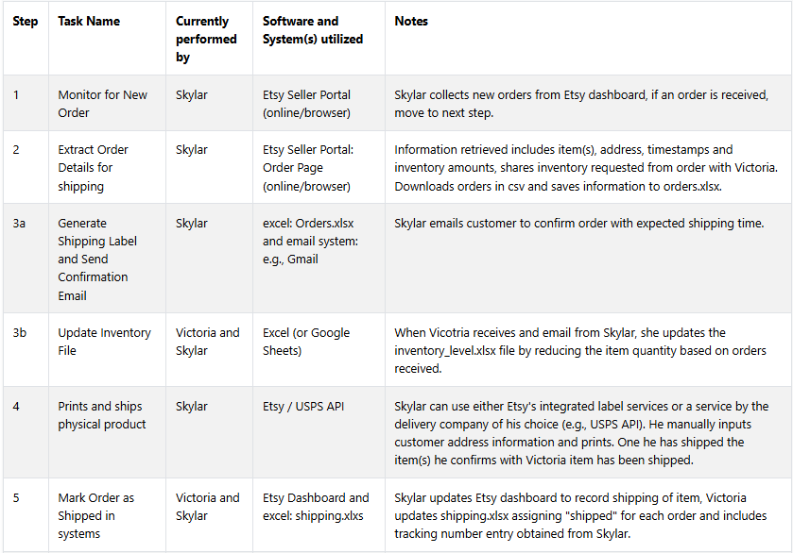

Slide 8
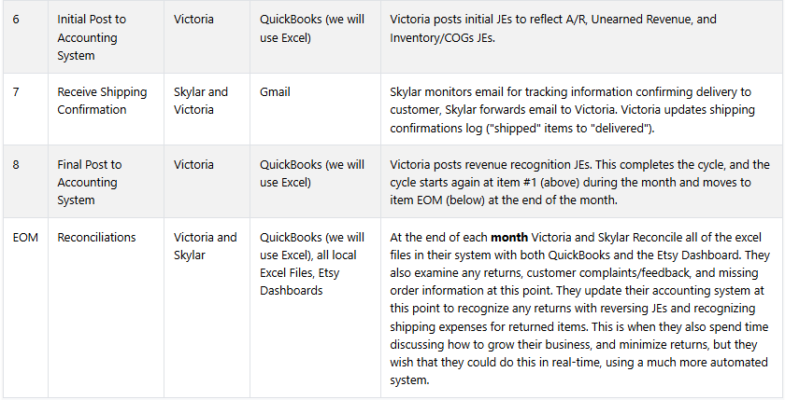

Slide 9
Agenda
Review
Pure Reformed Oils Case: Overview
Lab Part I: Introduction and Mapping the Process

Slide 10
Mapping the process
Objective:
Using LucidChart, outline a proposed RPA solution to the workflow and make notes of the inefficiencies that are solved via automation.
Questions to discuss:
What systems/software are interacted with? (map these first)
Who interacts with the software? (ask: do they need to be mapped?)
Where is their duplication, inefficiencies, or areas where human errors could occur?

Slide 11
Thank you

