Slide 1
Introduction to Robotic Process Automation (RPA)
Adv. Advisory | ACCTG 528
MPAcc Class of 2025

Slide 2
Agenda
Review
RPA Background Material
Lab: Our First Bot

Slide 3
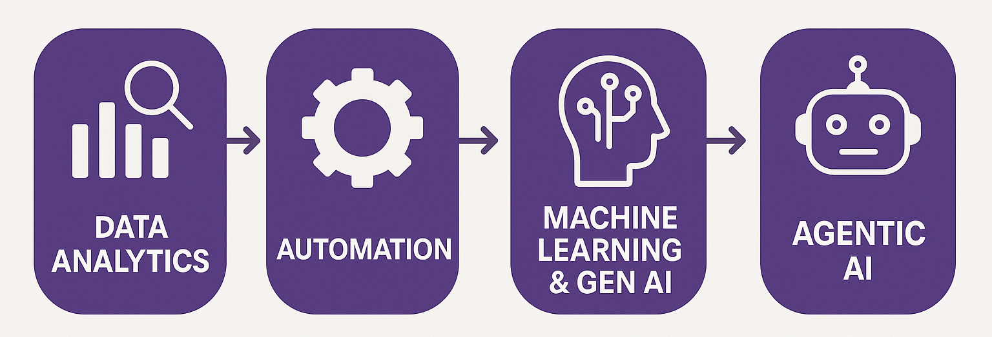
Course Overview

Slide 4
Agenda
Review
RPA Background Material
Lab: Our First Bot

Slide 5
Defining RPA:
Definition:
Robotic Process Automation
Software that mimics human action and connects multiple fragmented systems and activities together through automation without changing the current enterprise IT landscape
PAST
EMERGING
PRESENT
1990’s–2000’s
2015–2020
2020-2025
2025+
Mimics human intelligence
Augments human intelligence
Incremental value
Mimics human actions
Cognitive intelligence
(CI)
Semi-cognitive/ intelligent automation
(Rule-based) Robotic Process Automation
(RPA)
Structured data interaction
Improved workflow
Optimized process
through automation
LLMs and pattern based machine learning
Cognitive AI, fully Autonomous AI
Notes:
Unwinds legacy of people-based quick fixes
Performs laborious and repetitive tasks reliably
Scalable up and down to match peak loads
Emulates business user behavior
Shift existing talent from data entry to data analysis

Slide 6
The real power of automation:
RPA takes the robot out of the human

Slide 7
RPA implementation steps:
Identify the right process(es) to automate:
Review the process characteristics previously identified that can be best suited for RPA.
Understand the process:
Ensure a complete understanding of the process to be automated, including the different systems that will be engaged, the data inputs and outputs used, any checks or controls imposed and all people involved in the process.
Develop a flowchart of the process:
Helps ensure all steps and the logical flow of the process are known (including when there may be decisions that lead to different outcomes).
Flowcharts are often the way RPA software programs (or tools) organize the process steps for automation.
It is also often helpful to break the process into smaller, more manageable sub-processes.

Slide 8
RPA implementation steps:
Program the bot using an RPA tool:
The process for programming the bot will vary based on the tool.
Test the bot:
Before implementing the newly automated task, it is critical that you test it to make sure everything works as required.
Testing should be performed periodically to ensure the bot is functioning as required.
Deploy the bot:
The organization will use the bot in accordance with approved standards and methodologies.

Slide 9
Agenda
Review
RPA Background Material
Lab: Our First Bot

Slide 10
RPA Cases
Guessing Game / Our first RPA Bot (and user/input controls):
Understanding loops, variables, process flows, and try/catch.

Slide 11
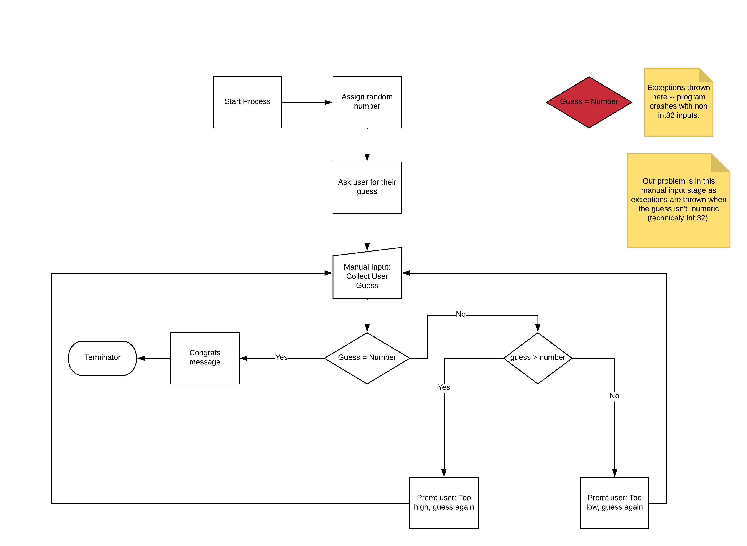

Slide 12
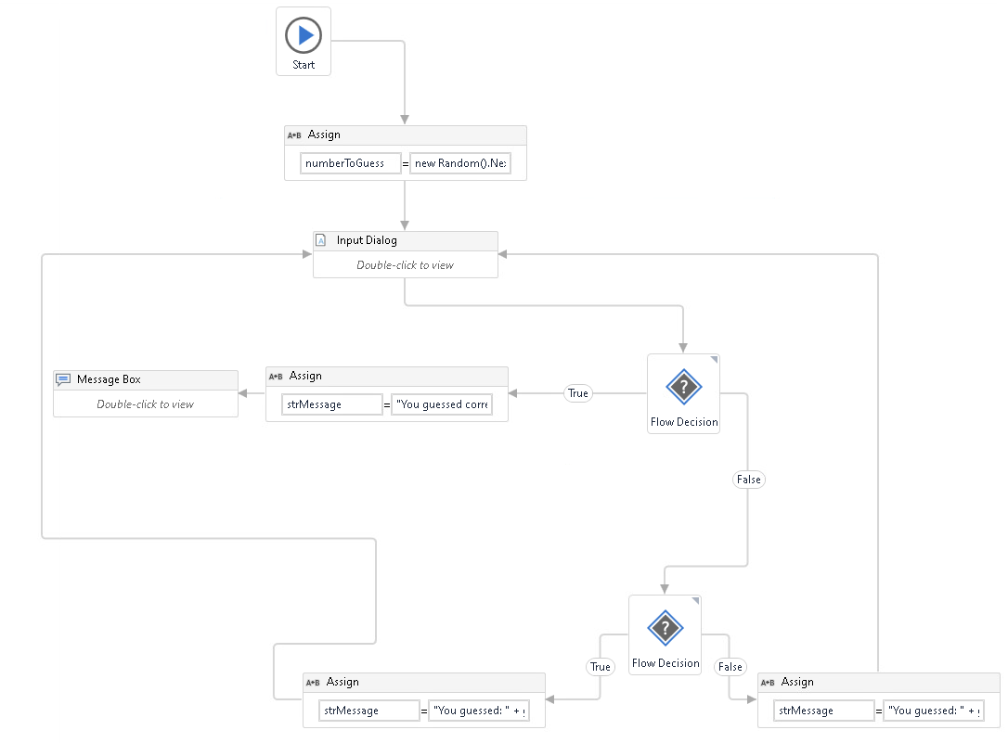

Slide 13
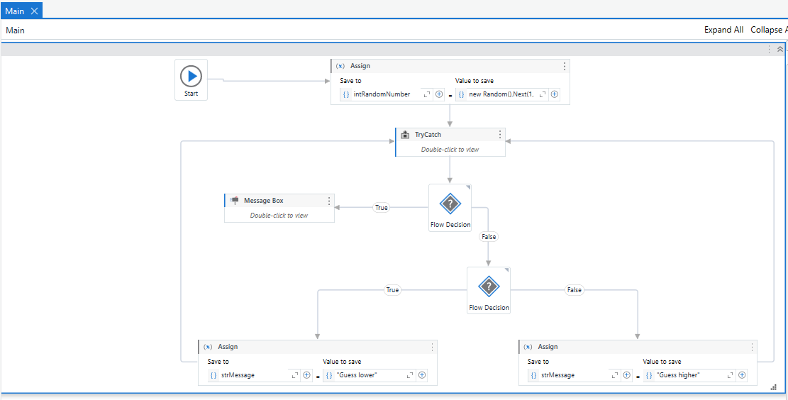

Slide 14
Lab: Navigating UIPath’s User Interface (UI)

Slide 15
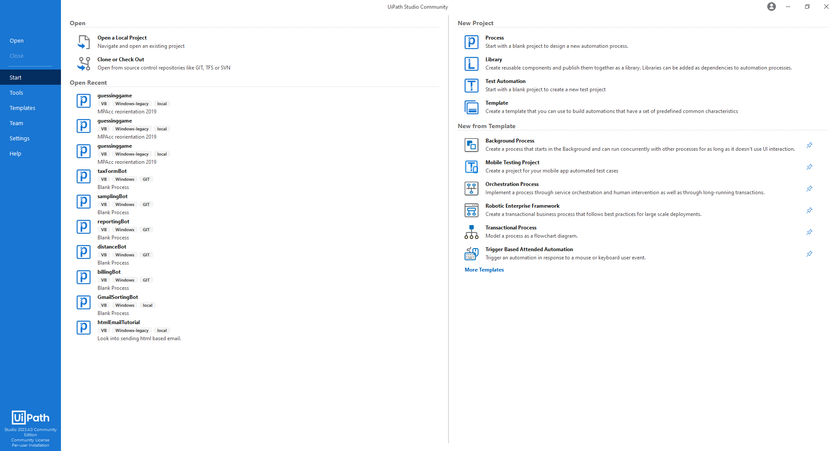

Slide 16
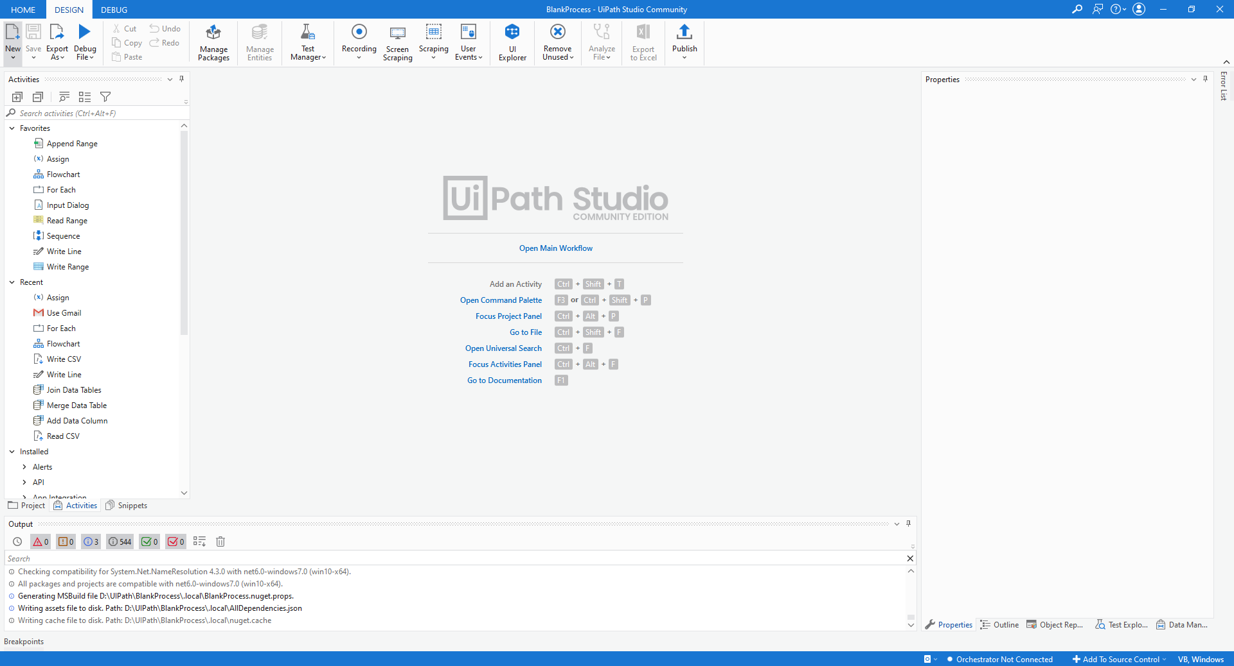
Properties about activities
Toolbar/
ribbon
Write and program bot here
Activities you might perform
Log / Output details

Slide 17
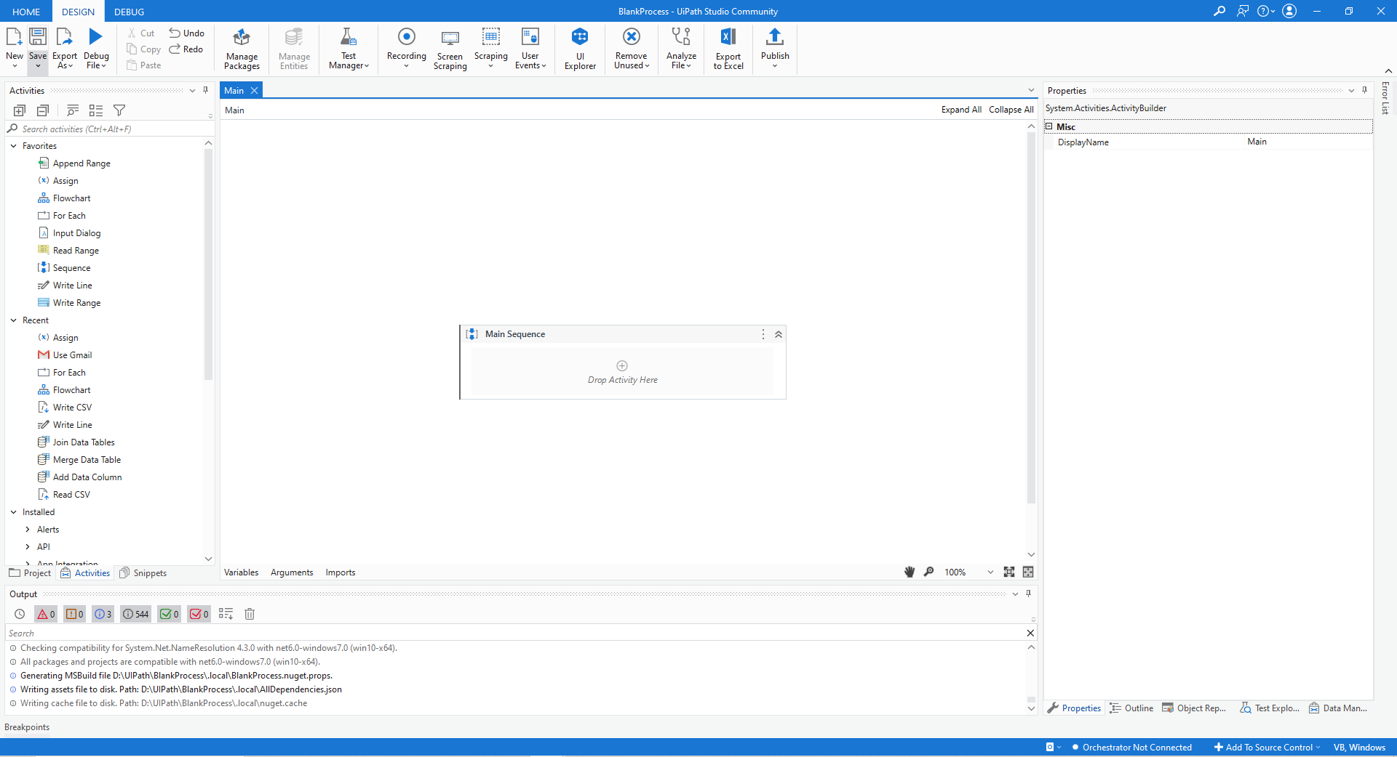
Write and program bot here
Default activity
Variables details (hidden)

Slide 18
Important UIPath Commands
Activities Tab (left): Where the activities (i.e., tools) can be found and added to a workflow
Properties Tab (right): Where we edit the activities on the workflow.
Control + k: allows us to use “Set Var:” to create a new variable.
Variable Tab (bottom of screen):
Name: The name assigned to the variable
Variable Type: The format the variable is stored as (e.g.: Integers, String etc)
Scope: The part of the workflow in which the variable can be accessed
Default: A default value for the variable.

Slide 19
Today’s bot extra hints:
The formula for the “numberToGuess” is new Random().next(1,101)
The variable guess is saved from the “Input Dialog” Activity in the “Output/Result” remember to create the variable using Control + k.
The first flow decision uses the logic guess=numberToGuess (with true going to congrats message and false to the next flow decision)
The second Flow Decision uses the logic guess>numberToGuess (with true going to the “too high” hint and false going to the “too low” hint.

Slide 20
Thank you

