Slide 1
Advanced Cass in Advisory Services: Introduction
Adv. Advisory | ACCTG 528
MPAcc Class of 2025

Slide 2
Agenda
Course Overview
Syllabus
Internship Reflection
UIPath Licenses
LucidChart Process Maps Exercise

Slide 3
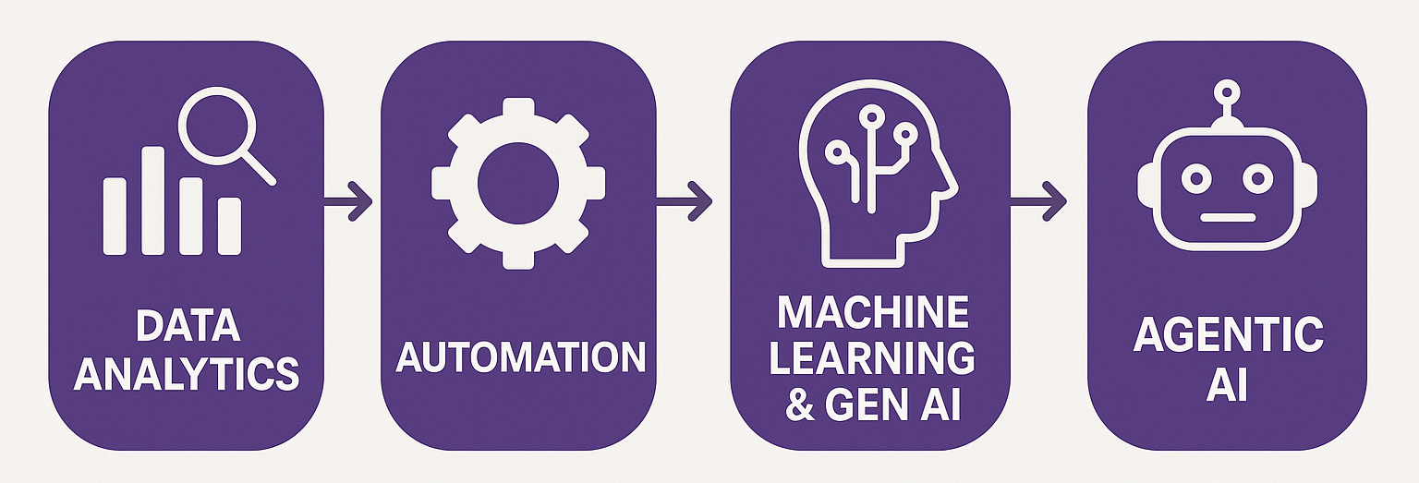
Course Overview

Slide 4
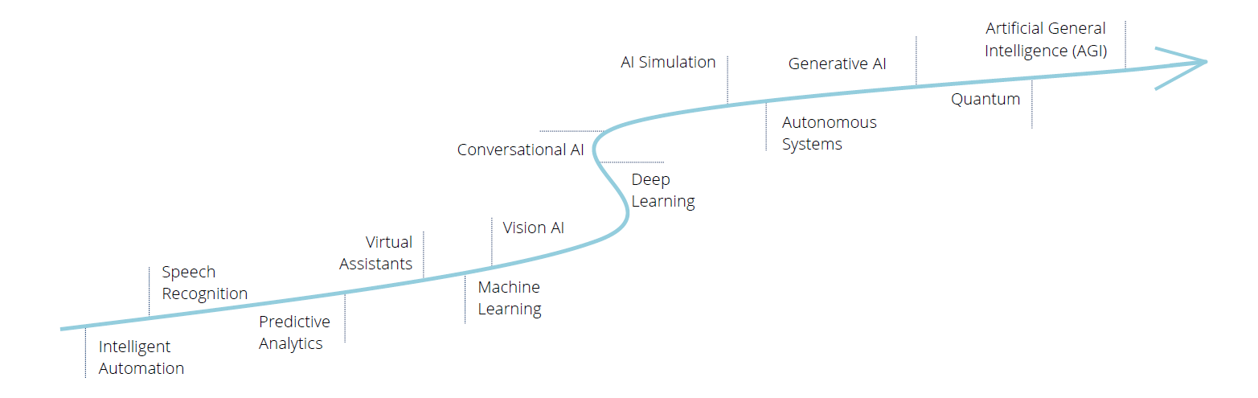
Automation Technology Progression with AI

Slide 5

What can we expect robots to do?

Slide 6
Automation using Rules versus Decisions
Rules
Can automated using logic such as “if x>200 then …”
Even complex rules can be automated if no decision is required (e.g., filling out long structured forms from existing data)
Decisions
Harder to automate until recently, requires reasoning.
Newest Generative AI models are now able to provide their reasoning, making some decisions automatable, for example summarizing information, extracting document meaning, executing higher logic (e.g., applying leasing standards)

Slide 7
Core Capabilities: Doc & Data Intelligence
Doc Intelligence
Automated understanding and summarization of documents
Quick extraction of important points and data from any text
Comparison of document contents to identify key differences
Accurate language translation for diverse document types
Trend and pattern detection within large volumes of text
Data Intelligence
Connect to any data source, integrating seamlessly with AI.
Utilize AI to uncover deep insights from complex datasets.
Empower finance to do real-time decision-making with dynamic, AI-driven data analysis.
Leverage predictive analytics to forecast trends and guide strategic planning.

Slide 8
AI Engagement Models: Prompt vs. Automated
Prompt-Response
Use an AI assistant for direct, real-time interaction to receive immediate feedback and assistance.
Adaptive AI responses evolve from each user interaction, enhancing accuracy and relevance.
Enable swift problem-solving and decision support, improving overall efficiency and user experience.
Automated
AI operates in the background based on predefined prompts and conditions.
Conducts continuous background processing for data analysis, info generation, and monitoring.
Automates tasks to streamline operations and prepare actionable insights without user intervention.

Slide 9
Agenda
Course Overview
Syllabus
Internship Reflection
UIPath Licenses
LucidChart Process Maps Exercise

Slide 10
Syllabus Discussion
https://www.ashercurtis.me/teaching/courses/acctg528/syllabus.html
https://www.ashercurtis.me/teaching/courses/mpacc/common_spring_project.html (preview version)

Slide 11
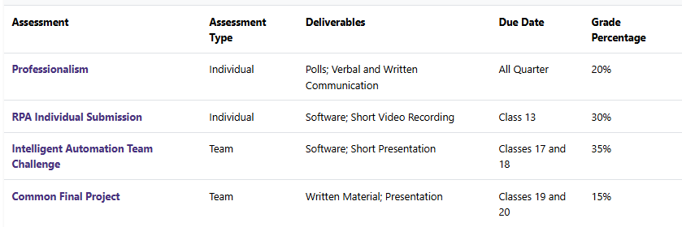
Assessment

Slide 12
Agenda
Course Overview
Syllabus
Internship Reflection
UIPath Licenses
LucidChart Process Maps Exercise

Slide 13

Automating Excel
In pairs, discuss of a process or task you have performed in excel explain to each other how it meets the following criteria:
It is repetitive
It is possible to make data errors
It didn’t seem like rewarding work
and then submit the task to PollEverywhere.

Slide 14
Agenda
Course Overview
Syllabus
Internship Reflection
UIPath Licenses
LucidChart Process Maps Exercise

Slide 15
Lab links (also online)
Remote Labs: https://fprod-hcs.foster.uw.edu/
UIPath License: https://www.uipath.com/rpa/academic-alliance/academic-studio-download
LucidChart: https://www.lucidchart.com/

Slide 16
Thank you

