Slide 1
CASES in Generative AI Risks part I
Advanced Cases in Assurance Services (ACCTG 521)
Class 16 | MPAcc class of 2025

Slide 2
Agenda
Review
Overview
Deliverable (by Thursday)
Lab:
Testing Data Veracity for Pure Oils

Slide 3
Review: Alteryx Tool Mastery

Slide 4
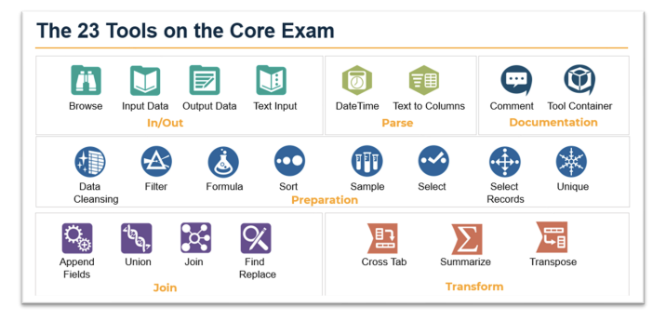

Slide 6
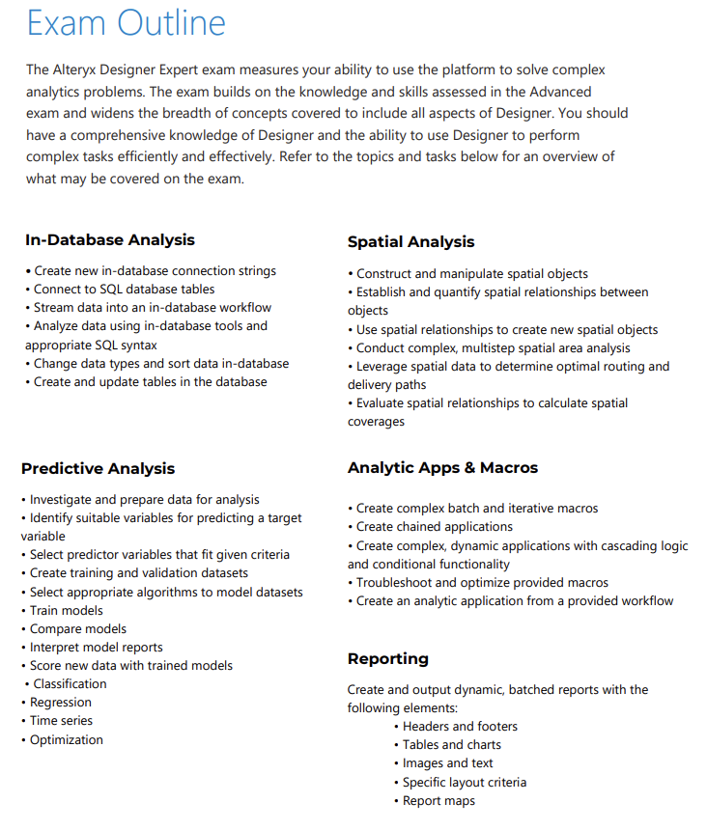

Slide 7
Agenda
Review
Overview
Deliverable (by Thursday)
Lab:
Testing Data Veracity for Pure Oils

Slide 9
Pure Oils Data Veracity Testing
Build a workflow that will serve as a macro template, which:
Performs Red-Flag Analysis on The Input Data
Performs a final assessment on whether the input data file passes/fails the test for Real data versus AI generated data.

Slide 10
Possible tests to perform (see final page of case for more):
Names-based tests:
Commonality of first and surnames
Name origin / nationality likelihood of names
Name and likelihood of gender matches
Middle Initials Tests
Hiring and dates-based tests:
Hires on weekends / holidays
Seasonal hiring increases
Job titles and salaries based-tests:
Similarity of compensation for similar jobs
Number of job titles
Other Analyses

Slide 11
Agenda
Review
Overview
Deliverable (by Thursday)
Lab:
Testing Data Veracity for Pure Oils

Slide 12
Deliverable (**Final individual Deliverable for my courses!!)

Slide 13
Deliverable
A 1-page memo with screenshot of your final Alteryx Macro workflow AND/OR screenshot of your data visualization of the risk of AI generated data.
The memo should answer the following:
What patterns and/or analyses were the most useful to identify red-flags?
What big picture concerns remain from reviewing this AI Generated data? i.e., knowing it is all fake, what are some key data veracity risks may surface in the future with Gen AI’s increased popularity.

Slide 14
Agenda
Review
Overview
Deliverable (by Thursday)
Lab:
Testing Data Veracity for Pure Oils

Slide 15
Agenda
Review
Overview
Deliverable
Lab:
Liberty Systems Cybersecurity Case

Slide 16
Thank you!

