Slide 1
Illuminating the Future of Cybersecurity
Illumen is pioneering the future of cybersecurity with innovative AI-driven solutions that empower organizations to easily assess their compliance posture against industry accepted security frameworks.
Samuel Bradley & Joshua Paulson

Slide 2
Illumen Overview: Pioneering AI-driven Security & Compliance
Cutting-Edge Technology
Comprehensive Approach
Trusted Expertise
Illumen leverages the power of artificial intelligence and machine learning to deliver unparalleled cyber security assessment results.
Illumen's solutions address the full spectrum of cybersecurity challenges, from governance and risk management to compliance and cyber security.
Illumen's team of cybersecurity experts bring deep industry knowledge and a passion for safeguarding organizations in the digital era.

Slide 3
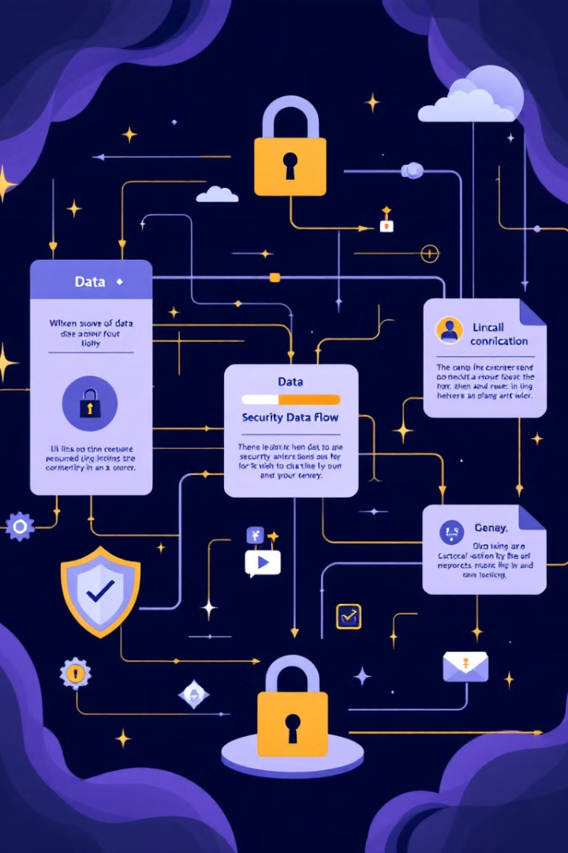
Agenda (1 of 2):
1
Cybersecurity Landscape
Delving into the cyber security domains, and evolving threats and challenges organizations face in the digital age.
2
Governance, Risk, and Compliance
Exploring a holistic approach to managing security, risk, and compliance requirements.
3
Security Frameworks
Navigating the complex landscape of security standards and best practices, and why they matter

Slide 4
Agenda (2 of 2):
4
Artificial Intelligence
How does AI impact security: the good, the bad, and the ugly.
5
Interactive Activity
Let’s get your hands on an AI use-case we are using in the field today.
6
Wrap-up
Recap and Q&A.

Slide 5
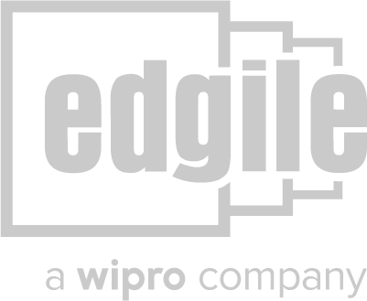
The Team
Samuel Bradley
Joshua Paulson
Chief Executive Officer & Co-Founder, with over 17 years of experience in enterprise security solutions.
Chief Technology Officer & Co-Founder, leveraging AI and machine learning to enhance cyber security assessments.
Experience
Experience
Alma Mater
Alma Mater
Contact
Contact

Slide 6
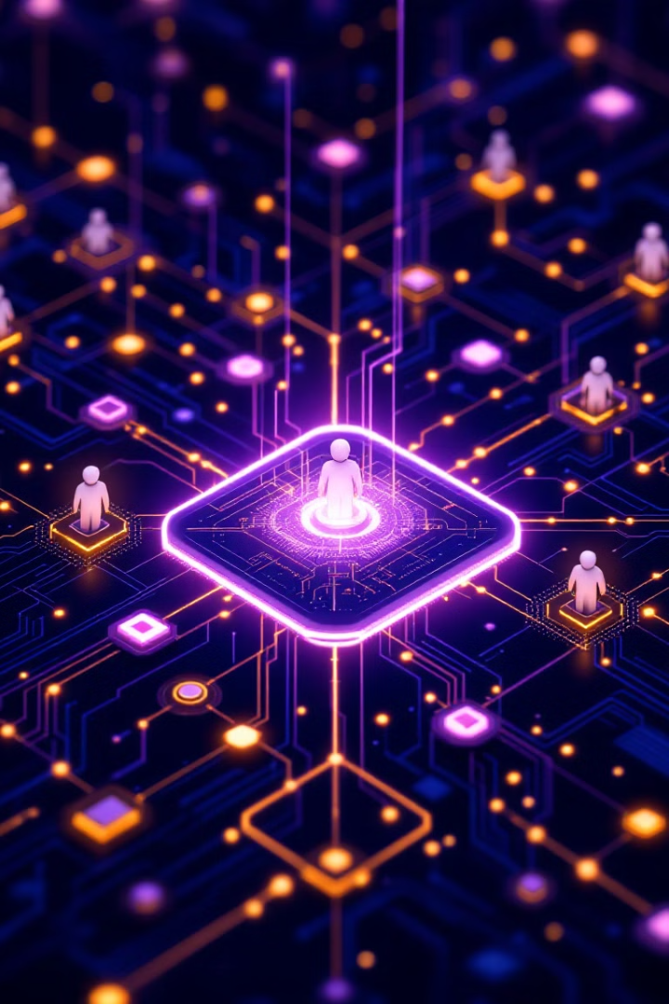
Cybersecurity Breakdown:
1
Architecture Security
2
Application Security
3
Network Security
4
Security Operations
5
Corporate Security
6
Physical Security

Slide 7
Cybersecurity Breakdown:
1
Architecture Security
2
Application Security
Immutable infrastructure, cloud security, server hardening, golden images, vulnerability mgmt., infra-as-code, encryption, backup & restore
Secure coding (OWASP), continuous integration / continuous deployment (CI/CD), code scanning (SAST/DAST), QA, staging, change control, access mgmt., PAM
3
Network Security
4
Security Operations
Segmentation, VPNs, load balancers, port scanning, certificate mgmt., encryption, vuln mgmt, pentests, access mgmt.
SIEM, incident response, threat intelligence monitoring
5
Corporate Security
6
Physical Security
Endpoint protection, email security, phishing, incident response, awareness
Badging, video surveillance, datacenter & cage security, physical pentests

Slide 8
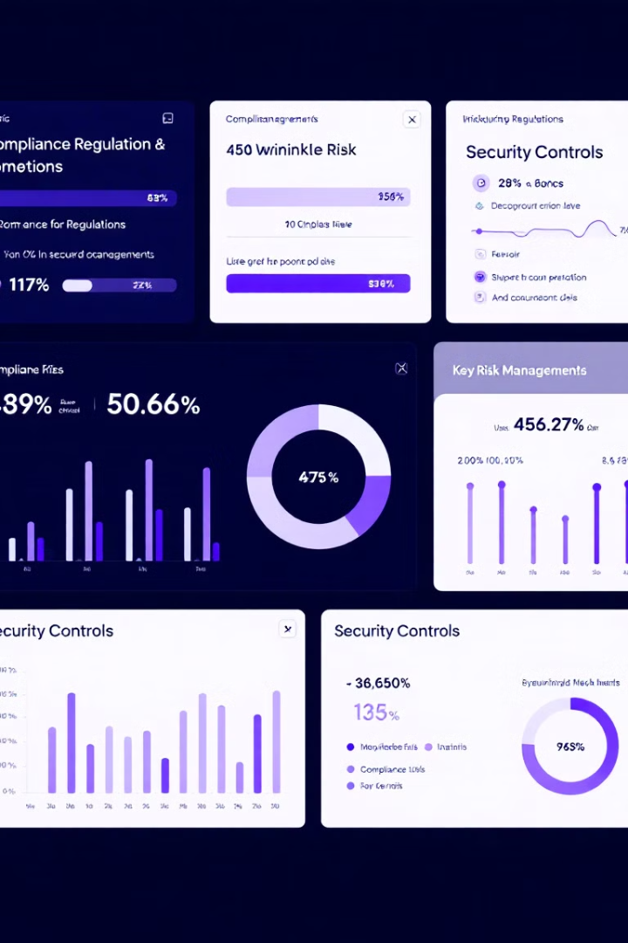
Governance, Risk, and Compliance: A Holistic Approach
Security
Risk Management
Implementing robust security controls to protect against evolving threats.
Identifying, assessing, and mitigating potential risks to the organization.
Compliance
Governance
Ensuring adherence to industry regulations and standards.
Establishing and enforcing policies and procedures to manage security and risk.

Slide 9
Governance, Risk, and Compliance Breakdown:
1
Governance
2
Risk Management
3
Compliance
4
Business Continuity
Policies, standards, procedures, steering committees, board meetings
Rollup of risks, top of the jigsaw puzzle, prioritization
Proving security, establishing trust
Resilience, availability, recoverability
5
Vendor Risk
6
Legal & Privacy
7
Internal Audit
8
Information Security
Supplier risk, due diligence, security reviews
Contract mgmt., consent, cookie mgmt, data sensitivity, data protection
Internal review of policies, controls and processes
All the aforementioned security domains

Slide 10
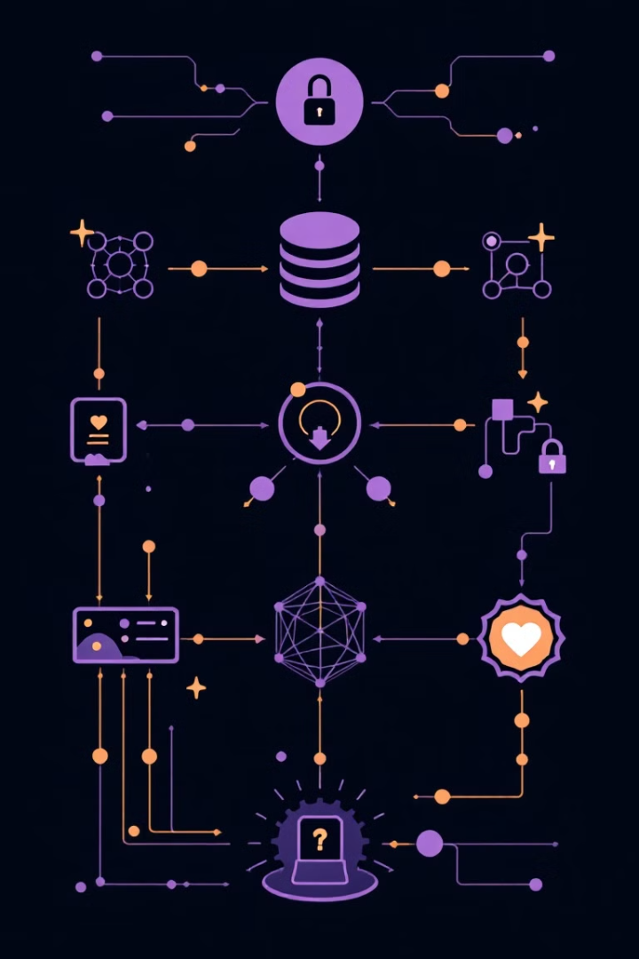
Security Frameworks: Why They Matter
1
SOC 2
Table steaks for companies to prove baseline security capabilities to their buyers (AICPA), often a non-negotiable
2
ISO 27001
An international standard for information security management systems (ISMS), widely accepted globally.
3
ISO 42001
Brand new security framework to use artificial intelligence safely and securely, for users and developers.

Slide 11
Security Frameworks: 00s of them
8
Global
ISO 27701, ISO 27018, ISO 27017, ISO 22301, ISO 20000, ISO 27001, ISO 42001, CSA STAR, CIS, SOC 1, SOC 2, SOC 3
…
Gov
FedRAMP H/M/L, DoD DISA IL 2/4/5, DFARS, EAR, NIST CSF, NIST 800-171, NIST 800-53, ITAR, CJIS, FIPS 140-2
…
Industry
PCI DSS, HIPAA, HITRUST, SOX, GLBA, FFIEC, FERPA, NERC-CIP

Slide 12
AI-powered Security: The Good, The Bad, The Ugly
The Good
The Bad
The Ugly
AI vastly improve organizations’ ability to identify and respond to vulnerabilities and threats quickly and succinctly. AI can also make managing numerous security compliance frameworks much easier.
On the flip side, AI greatly enhances the ability of threat actors to exploit vulnerabilities quickly. Zero days are likely to become even more common.
No one really knows just how far AI will go, and what the implications will be for securing organizations and maintaining trust and transparency across our markets.
Notes:
Discuss all the ways cybersecurity is being improved by AI:
Automated Incident Response: AI can automate responses to certain low-level security incidents. Using AI-powered playbooks, organizations can streamline response actions (such as isolating devices or blocking IP addresses) to contain threats quickly, especially helpful in large-scale networks where human intervention is too slow.
Discuss how cybersecurity is worsened by AI:

Slide 13
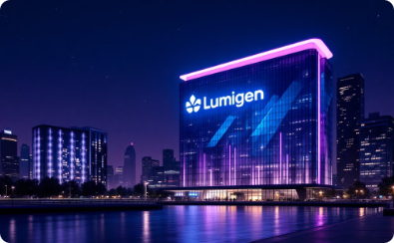
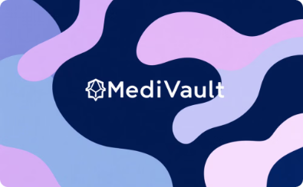
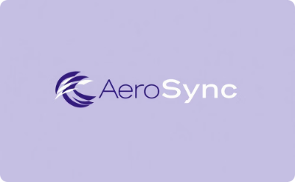
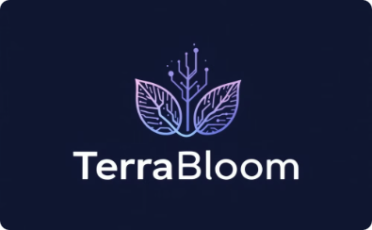
Activity: Assess Your Organization with AI
Engage in an interactive session to explore practical steps your organization can take to enhance its cybersecurity posture. Each team will assess one of the following four fake companies: LuminoGen, MediVault, AeroSync, and TerraBloom, against the NIST 800-53 r5 framework for control gaps and improvements.
LuminoGen
MediVault
AeroSync
TerraBloom
Specializes in developing and deploying smart grid solutions for renewable energy.
Specializes in secure data storage, analytics, and digital solutions for healthcare providers.
Designs and develops mission-critical software and avionics systems for the aerospace industry.
Develops advanced environmental monitoring systems and smart agriculture solutions.

Slide 14
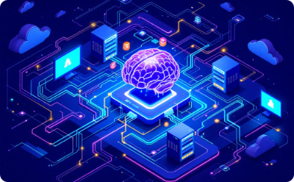
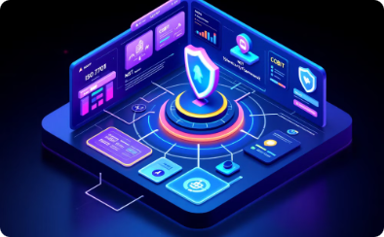
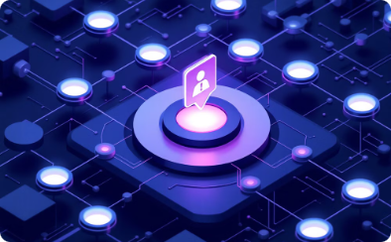
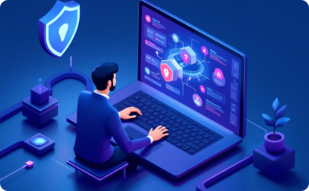
Imagine the Possibilities
Intake large unstructured data for large multinational companies.
Assess multiple complex, industry-leading security frameworks simultaneously.
Automatically identify gaps in security against these frameworks.
Generate detailed remediation activities, and plot on a roadmap, in seconds.

Slide 15
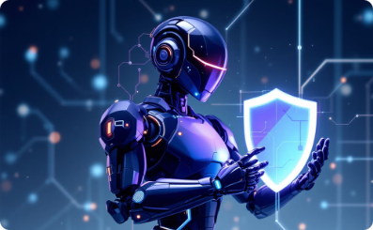
AI-Powered Security Assessment Agents
Framework Mapping
Gap Analysis
Remediation Planning
Continuous Optimization
AI agents link security controls to standards and regulations.
Agents identify gaps and vulnerabilities in security.
Agents suggest solutions to fix security issues.
Agents monitor and adapt to new threats.
Illumen's AI-powered security assessment solution deploys a team of specialized "agents" to comprehensively review an organization's security posture against industry-leading frameworks. Each agent brings unique expertise, working together to deliver precise, actionable insights.
By leveraging the collective intelligence of specialized AI agents, Illumen delivers a robust, data-driven security assessment that empowers organizations to strengthen their security posture and achieve compliance with confidence.

Slide 16
Real Life Example
Link

Slide 17
Closing Thoughts and Q&A
Illumen is committed to empowering organizations with the latest AI-driven security solutions and expert guidance to stay ahead of evolving cyber threats, streamlining traditional security assessments, and disrupting the traditional (and expensive) compliance assessment process used today

