Slide 1
Post-Preliminary Proposal Group Project Workshop II
Advanced Cases in Assurance Services (ACCTG 521)
Class 11 | MPAcc class of 2025

Slide 2
Agenda
Review
Labs demo using Tesla with Alteryx to:
Pull all XBRL data from the Company Facts API
ETL to transform data from json format to an Alteryx File
Explore the data and transform to annual (or quarterly)
Team Workshop:
Apply to your company/companies.
Extend the ETL to transform the data you are extracting to numeric and calculate a ratio.

Slide 3
Review

Slide 4
Identify company CIK (e.g., search EGDAR)
Use CIK to download submissions to identify the accession number
Use the accession number to download the 10-K
Identify company CIK (e.g., search EGDAR)
Use CIK to download company facts to retrieve XBRL Filings

Slide 5
Agenda
Review
Labs demo using Tesla with Alteryx to:
Pull all XBRL data from the Company Facts API
ETL to transform data from json format to an Alteryx File
Explore the data and transform to annual (or quarterly)
Team Workshop:
Apply to your company/companies.
Extend the ETL to transform the data you are extracting to numeric and calculate a ratio.

Slide 6
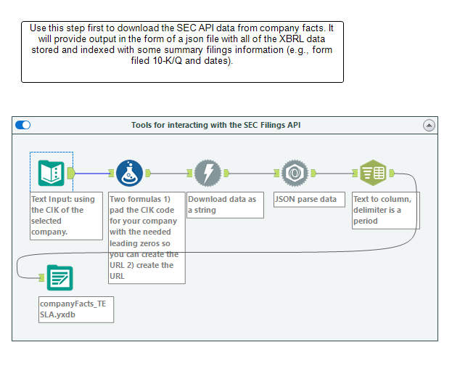

Slide 7
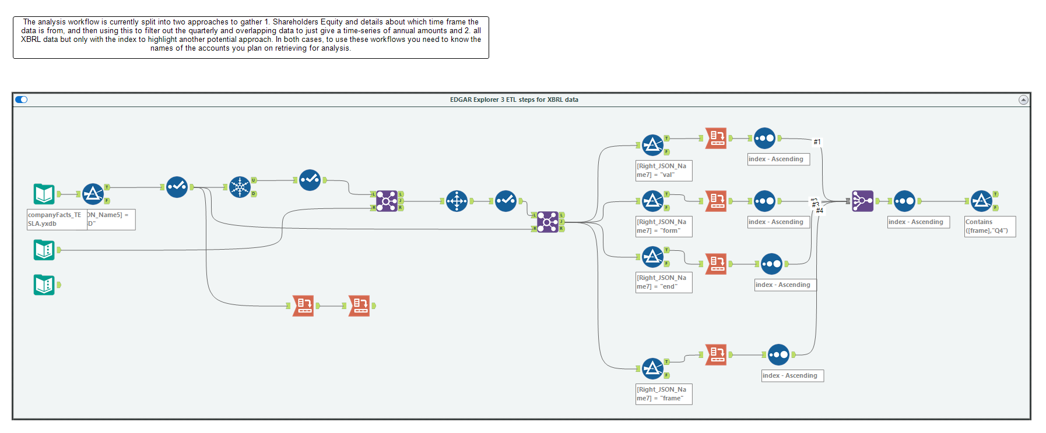

Slide 8
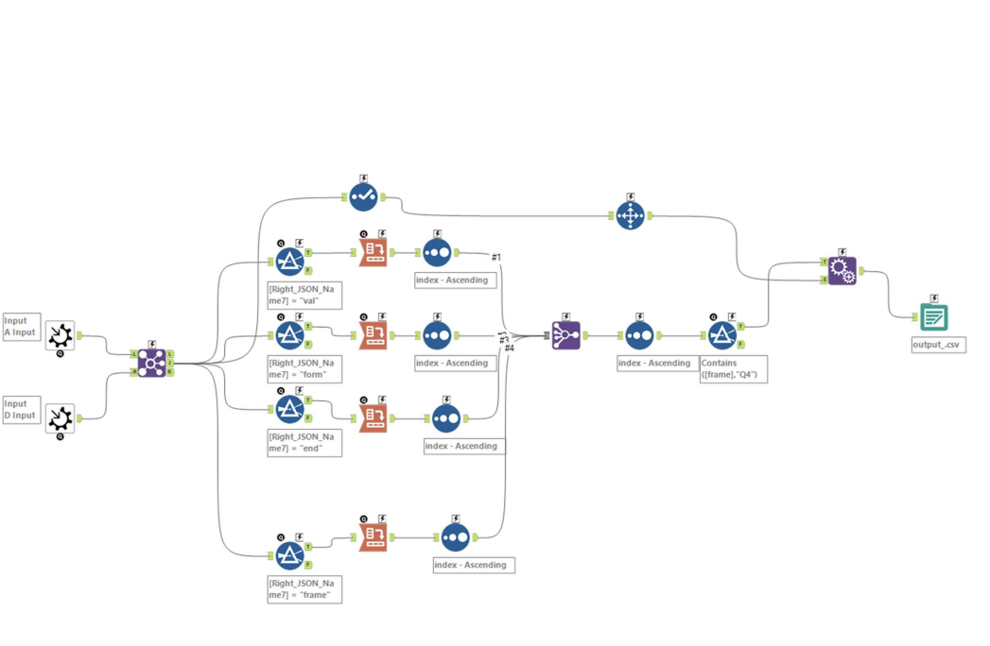

Slide 9
Thank you!

