Slide 1
Innovative Data Sources and Tools: Generative AI
Data Analytics for Professional Accountants (ACCTG 522)
Class 7 | MPAcc Class of 2025

Slide 2
Welcome!
Class Agenda
Review
Brief Overview on Generative AI
Labs:
  Pure Oils Part 1 (Chat GPT and Python)
  Pure Oils Part 2 (Alteryx)
Conclusion and look ahead

Slide 3
The Analytical Mindset
The Analytical Mindset is defined as the ability to work with data to apply appropriate analytics and interpret and share insight with stakeholders.

Slide 4
Why do we care about Extract, Transform & Load (ETL)?
The Extract, Transform & Load or ETL Process is the first task required to complete the analytical process.
In most cases, data required for the analytical process is stored in a database and must be extracted from that database and loaded into analytics software.
More challenging extraction (typically unstructured) require more advanced tools.

Slide 5
Welcome!
Class Agenda
Review
Brief Overview on Generative AI
Labs:
  Pure Oils Part 1 (Chat GPT and Python)
  Pure Oils Part 2 (Alteryx)
Conclusion and look ahead

Slide 6
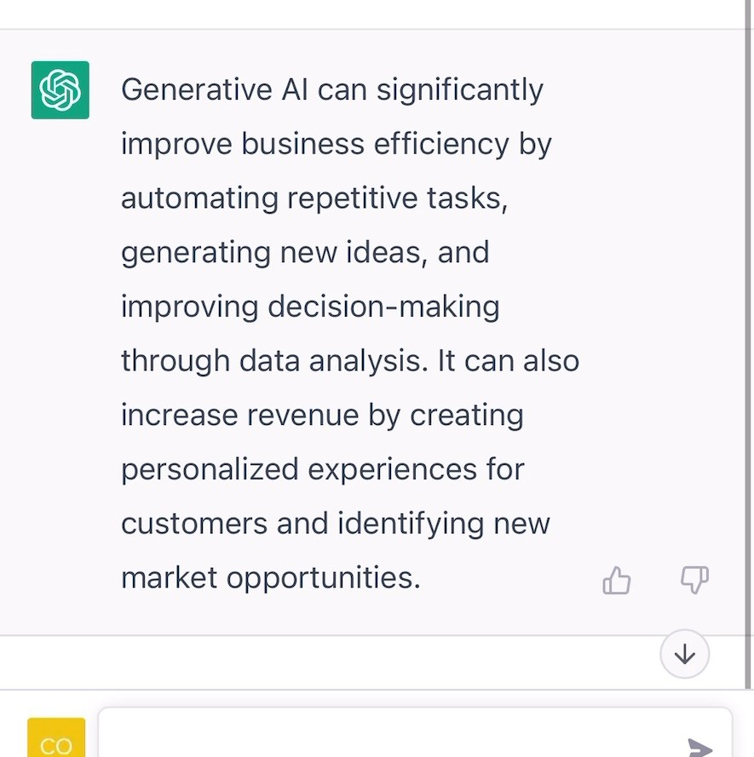

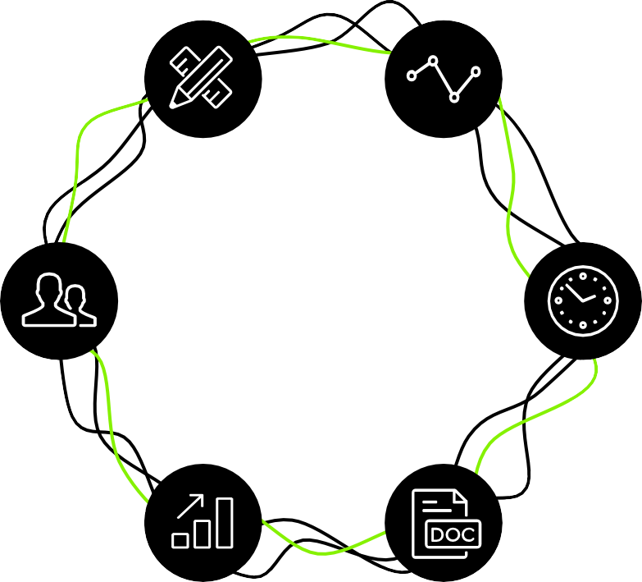

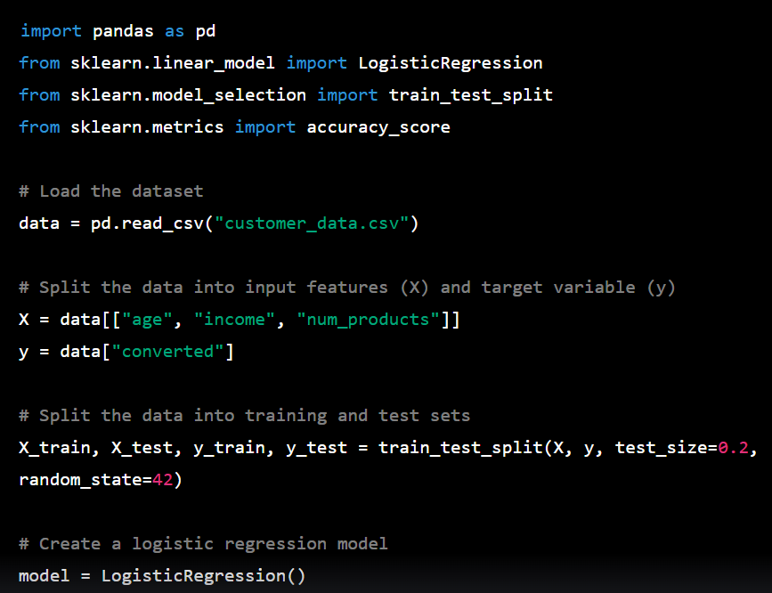

Generative AI capabilities
Generative AI can produce a wide range of outputs depending on the specific application and type of data that is needed. Here are some common output types that are applicable to business
Text
Video
Prompt: Explain the business impact of Generative AI in 50 words
Prompt: Create a video of a teddy bear painting a portrait
Image
Code
Prompt: A bowl of soup that is a portal to another dimension as digital art
Prompt: In python, code a program that predicts the likelihood of customer conversion
Phone / Voice
Multi-Lingual
Multiple Tasks
Empathy / Humor
Ensures Resolution
Systems Integration
Audio
3D
Generative AI-powered customer service agents
Prompt: A beautiful dress made out of garbage bags, on a mannequin. Studio lighting, high quality, high resolution.
Notes:
Casey
Examples of Generative AI outputs based on prompts:
Text: Producing human-like text in an easy-to-read conversational format (ChatGPT);
Image: generation, creating realistic images or adding to images based on human input
Audio: creating media using synthetic voices and editing or translating existing audio
Video: creating scenes from scratch or transforming existing videos into new ones for storyboarding
Code: generation – interpreting commands in natural language and sharing with programmers; at Deloitte we’re using Gen AI for code generation in our SAP environment; also using it to automate testing scripts prior to deployment to production.
3D

Slide 7
Core Capabilities: Doc & Data Intelligence
Doc Intelligence
Automated understanding and summarization of documents
Quick extraction of important points and data from any text
Comparison of document contents to identify key differences
Accurate language translation for diverse document types
Trend and pattern detection within large volumes of text
Data Intelligence
Connect to any data source, integrating seamlessly with AI.
Utilize AI to uncover deep insights from complex datasets.
Empower finance to do real-time decision-making with dynamic, AI-driven data analysis.
Leverage predictive analytics to forecast trends and guide strategic planning.

Slide 8
AI Engagement Models: Prompt vs. Pre-Prompt
Prompt-Response
Use an AI assistant for direct, real-time interaction to receive immediate feedback and assistance.
Adaptive AI responses evolve from each user interaction, enhancing accuracy and relevance.
Enable swift problem-solving and decision support, improving overall efficiency and user experience.
Pre-Prompt
AI operates in the background based on predefined prompts and conditions.
Conducts continuous background processing for data analysis, info generation, and monitoring.
Automates tasks to streamline operations and prepare actionable insights without user intervention.

Slide 9
Welcome!
Class Agenda
Review
Brief Overview on Generative AI
Labs:
  Pure Oils Part 1 (Chat GPT and Python)
  Pure Oils Part 2 (Alteryx)
Conclusion and look ahead

Slide 10

Lab Part 1
Help Skylar Swindler at Pure Oils provide evidence of his company’s legitimate existence:
Single Prompt (“One Shot” approach)
Multi prompts with Iterative Refinement
Use as a Coding Assistant
Generate data for 110 current employees in csv format

Slide 11

Lab Part 2
Assess the output files from classmates:
Alteryx workflows:
  Generate a diagnostic for a fake/AI generated csv file
  Look for red flags, set up tests, use Alteryx to help find and document the red flags

Slide 12
UniqueID: A unique identifier that was added to the dataset after it was compiled. It has no meaning other than to uniquely identify each row and make it easier to refer to a specific line of data.
LastName: The employee’s last name. If they do not have a last name in the database, it is listed as “NA”.
MiddleInitial: The employee’s middle initial. If they do not have a middle initial in the database, it is listed as “NA”.
FirstName: The employee’s first name. If they do not have a first name in the database, it is listed as “NA”.
Gender: The gender of the employee: male, female, or other.
Job Title: The employee's current job title.
Department: The department in which the employee works.
HireDate: The date the employee was hired. Listed as dd/mm/yyyy. Dates can range from 6/23/1951 through 12/31/2023.
TerminationDate: The date the employee was terminated from the organization. Listed as dd/mm/yyyy. If an employee has not been terminated, this field should be null.
AnnualSalary: The employee's base annual salary for the fiscal year.

Slide 13

Thank you!

