Slide 1
Misstatement Risk (and internal controls)
Advanced Cases in Assurance Services (ACCTG 521)
Class 5 | MPAcc class of 2025

Slide 2
Agenda
Review
Overview
Internal Controls Testing and Governance
Labs
Transaction Analysis

Slide 3
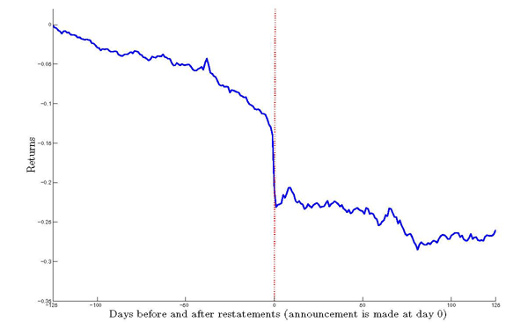
Market response to restating firm
Average abnormal returns below negative 9%
Why might investors perceive a restatement as bad news?

Slide 4
Disclosure requirements
Annual report
Required
Section 302
Section 404a
Section 404b
Management
Disclosure
Management
Document and Test
Auditor Opinion

Slide 5
Material Weaknesses and Financial Reporting Quality
Are Material Weaknesses Correlated with Restatements?
Internal control weaknesses predict restatements
Why doesn’t substantive testing fix this?
It does, sometimes. When the material weaknesses are account specific, they do NOT have more restatements (i.e., substantive testing works)
BUT when the problem is more general (e.g., segregation of duties, IT weaknesses), it is hard to know where to apply additional substantive testing. (Ge et al. 2007)

Slide 6
Agenda
Review
Overview
Internal Controls Testing and Governance
Labs
Transaction Analysis

Slide 7
Overview
Notes:
We will establish the importance of the analytical mindset using the model developed for the MPAcc, but can easily be applied to any career path.

Slide 8
Transaction analytics
Today we will start analyzing transaction data:
Central to both the external audit function and internal audit function.
Transaction analysis can also be used by management to assess operational decisions.

Slide 9
Transaction analytics
External auditors provide opinions a company’s financial statements are presented fairly, in all material respects, in accordance with financial reporting framework (such as GAAP).
External auditors can also provide advisory services to help the company become more financially secure/agile, among other areas.
Internal auditors ensure that company policies and procedures are followed and that the company is financially efficient.

Slide 10
Transaction analytics
Internal auditors ensure that company policies and procedures are followed and that the company is financially efficient.

Slide 11
Why is transaction analysis important?
Notes:
We will establish the importance of the analytical mindset using the model developed for the MPAcc, but can easily be applied to any career path.

Slide 12
Effective Financial Reporting Governance
Board
Management
Independent Auditor
Audit Committee
Chief Financial Officer
Chief Accounting Officer
National Office
Engagement Teams
Internal Audit
Technology and Systems
Rule- and Standard-Setters:
SEC, Exchanges, PCAOB, FASB, IASB, COSO, IIA
Sound Financial Reporting
Notes:
Bob – Course Overview (3 legged stool)
Christina – Refer to Syllabus and go into depth on professionalism piece
See if class has any questions on syllabus

Slide 13
Management
Audit
First Line of Defense
Second Line of Defense
Third Line of Defense
Management Control
Enterprise Risk Management
Internal Audit
Legal & Privacy
Physical Security
The Business / Operations
Third Party Risk Management
Cybersecurity
Business Continuity Management
Compliance

Slide 14
Why is transaction analysis important?
Better financial reporting governance leads to better quality financial reporting.
One potential avenue is from detecting and preventing fraud.
Transaction analytics for fraud prevention and detection is seen as a major step towards efficiently reducing fraud.

Slide 15
Agenda
Review
Overview
Internal Controls Testing and Governance
Labs
Transaction Analysis

Slide 16
Transaction Analysis: Pcard

Slide 17
Conclusion
Better financial reporting governance leads to better quality financial reporting.
One potential avenue is from detecting and preventing fraud.
Transaction analytics for fraud prevention and detection is seen as a major step towards efficiently reducing fraud.

Slide 18
Thank you!

