Slide 1
Misstatement Risk (and internal controls)
Advanced Cases in Assurance Services (ACCTG 521)
Class 5 | MPAcc class of 2025

Slide 2
Agenda
Review
Overview
Misstatement Risk
Internal Controls
Labs
Factors associated with Restatements
Factors associated with Internal Control Weaknesses (time permitting)

Slide 3
Economics of Audit
Conflicting incentives for (i) firms to disclose and withhold information and (ii) for firms to undertake audits (or information verification).
Factors that influence demand for audit and therefore audit fee include:
Agency conflicts
Information asymmetry
Risk of intentional manipulation
Risk of unintentional errors
For example, firm size (i.e., total assets)

Slide 4
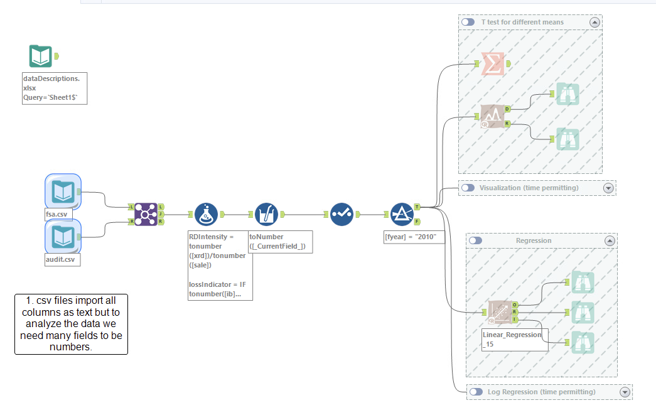

Slide 5
Audit Risk Model
Audit Risk: risk that the auditor expresses an inappropriate audit opinion when the financial statements are materially misstated
AR = IR x CR x DR
RMM
Inherent Risk: risk that a management assertion is materially misstated (before considering internal controls)
Control Risk: risk that internal controls fail to detect a misstatement
Detection Risk: risk that auditors fail to detect a misstatement

Slide 6
Audit Planning
Assessment of business risks is fundamental to thoughtful planning and execution of the audit.
Business risks provide helpful starting point for assessing financial statement risks.
Firm disclosures are helpful but can also contain boilerplate information or inconsistencies. Consider broad sources.
Materiality is judged by whether the information would change the decision of a reasonable investor
Materiality is based on qualitative and quantitative factors. It is subjective and requires judgment, but it is a critical starting point for understanding where to focus audit planning attention.

Slide 7
Agenda
Review
Overview
Misstatement Risk
Internal Controls
Labs
Factors associated with Restatements
Factors associated with Internal Control Weaknesses (time permitting)

Slide 8
What is a Misstatement? (AS2810.A2)
"A misstatement, if material individually or in combination with other misstatements, causes the financial statements not to be presented fairly in conformity with the applicable financial reporting framework. A misstatement may relate to a difference between the amount, classification, presentation, or disclosure of a reported financial statement item and the amount, classification, presentation, or disclosure that should be reported in conformity with the applicable financial reporting framework. Misstatements can arise from error (i.e., unintentional misstatement) or fraud.”

Slide 9
Material Misstatements
Material misstatements will cause a firm to restate their financial statements.
Many restatements are publicly announced in an 8-K.

Slide 10
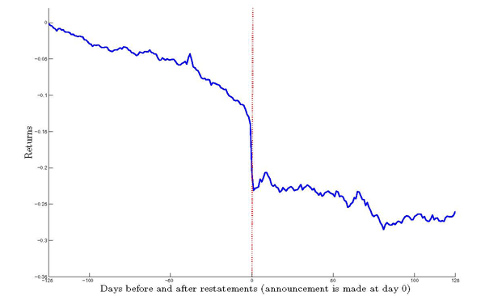
Market response to restating firm
Average abnormal returns below negative 9%
Why might investors perceive a restatement as bad news?

Slide 11
Impact on auditor of a client restatement
Auditors face a higher likelihood of litigation when a client restates
increasing for common frauds
and those including fictional transactions
Who do you expect brings legal action against the auditor? And why?

Slide 12
Impact on management of a misbehavior-related restatement
Firms with a misbehavior-related restatement had higher turnover in 13 months around restatement
49% of CEOs vs only 8% for error-related restatement
64% of CFOs vs only 12% for error-related restatement
91% of misbehavior restatements had either CEO or CFO leave
(Hennes, Leone, and Miller 2008)
More on misbehavior vs error related restatement:
Market reaction is -14% for misbehavior restatement, -2% for error-related restatement
80% of misbehavior has a class action lawsuit, while only 1% of error did

Slide 13
What firm characteristics might predict restatement risk?
Firm Characteristic | Measures | + / - ? | Why?
Accruals | ChgRec, ChgInv, RSST accruals, % soft assets
Firm Performance | ChgROA, ChgCashSales
Abn chg in # employees | AbnChgEmp
Off-balance sheet information | OperLeases
Stock / Debt market incentives | IssueDebtEquity
Growth expectations | StockReturns, BooktoMarket

Slide 14
Agenda
Review
Overview
Misstatement Risk
Internal Controls
Labs
Factors associated with Restatements
Factors associated with Internal Control Weaknesses (time permitting)

Slide 15
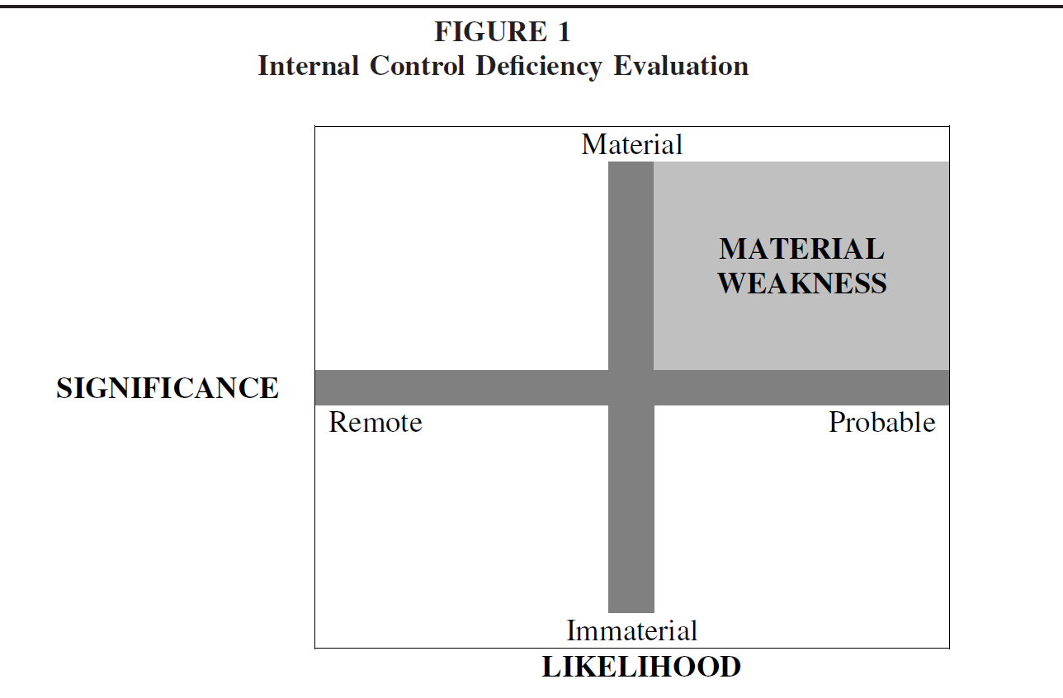
What is a material weakness?

Slide 16
What is a significant deficiency?
Material weaknesses need to be disclosed in the 10-K under Section 302 (and 404)
Significant deficiencies do not need to be publicly disclosed, but must be disclosed to the audit committee
Significant Deficiency
Significant Deficiency

Slide 17
How does this all work?
Example: Material weakness over allowance for doubtful accounts.
A firm does not have a policy for estimating allowance for doubtful accounts, instead just using last year’s percentage as the estimate.
If the credit-worthiness of the client base has worsened (e.g., because salespeople are trying to meet quotas, or because there is a systematic shock such as the financial crisis), then the allowance for doubtful accounts will be too low and could result in a misstatement.

Slide 18
How does this all work?
Example: Material weakness over inventory tracking.
A firm does not have an inventory tracking system.
When the inventory is counted at the end of the year, the inventory balance is updated. But if some inventory is not seen, in a warehouse closet, then inventory is misreported and there could be a subsequent misstatement.

Slide 19
Disclosure requirements
Annual report
Required
Section 302
Section 404a
Section 404b
Management
Disclosure
Management
Document and Test
Auditor Opinion

Slide 20
Material Weaknesses and Financial Reporting Quality
Are Material Weaknesses Correlated with Restatements?
Internal control weaknesses predict restatements
Why doesn’t substantive testing fix this?
It does, sometimes. When the material weaknesses are account specific, they do NOT have more restatements (i.e., substantive testing works)
BUT when the problem is more general (e.g., segregation of duties, IT weaknesses), it is hard to know where to apply additional substantive testing. (Ge et al. 2007)

Slide 21
What firm characteristics might be related to weaknesses in internal control over financial reporting?

Slide 22
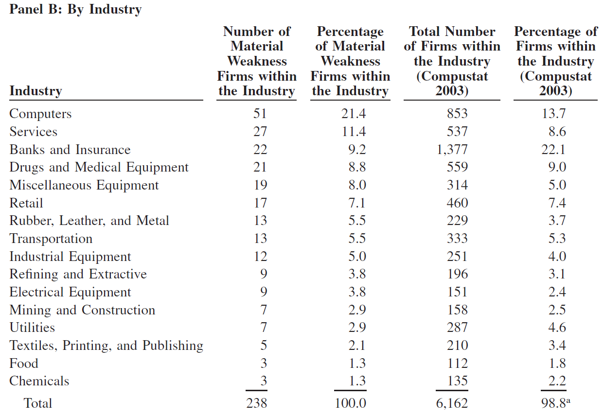
Early Post-SOX Evidence
Source:
Ge and McVay (2005, AH)
Notes:
Computer industry has the highest percent of material weakness firms. Banks and Insurance have only 9.2% of material weakness firms, even though they are 22.1% of Compustat firms, likely because they had more internal control regulations already through bank regulators.

Slide 23
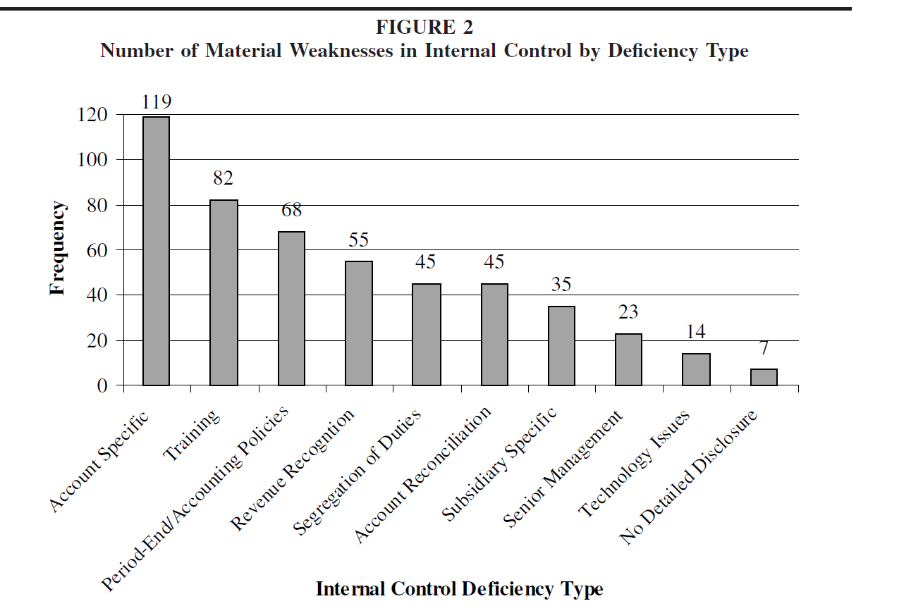
Source:
Ge and McVay (2005, AH)

Slide 24
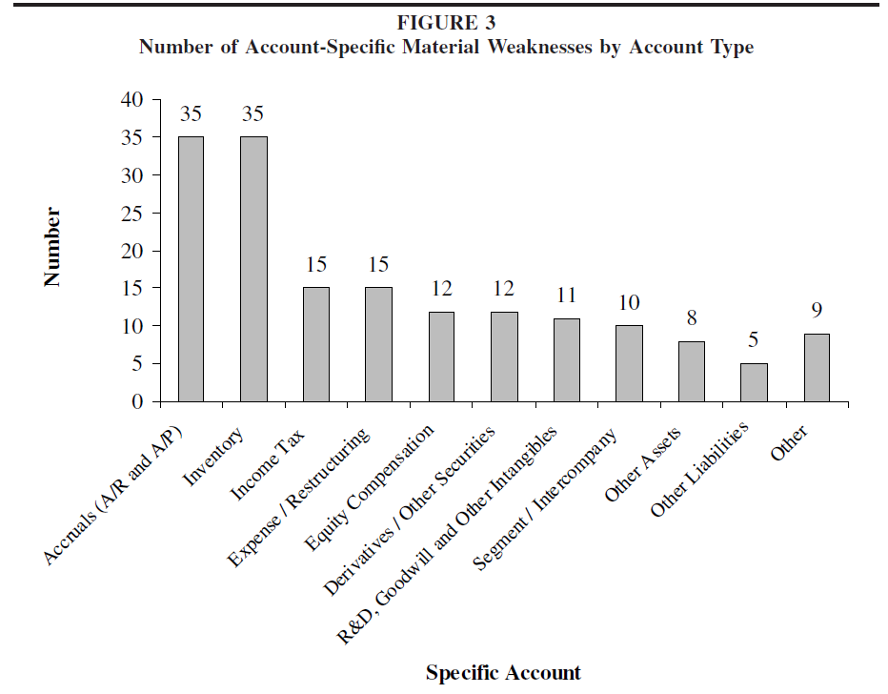
Source:
Ge and McVay (2005, AH)

Slide 25
Agenda
Review
Overview
Misstatement Risk
Internal Controls
Labs
Factors associated with Restatements
Factors associated with Internal Control Weaknesses (time permitting)

Slide 26
Thank you!

