Slide 1
Audit Risk and Materiality
Adv Cases in Assurance Services (ACCTG 521)
Class 4 | MPAcc class of 2025

Slide 2
Agenda
Review
Audit Risk and Planning
Overview
Qualitative Exercise: Identify Risks & Classify Accounts
Materiality Discussion
Semi-Quantitative / Qualitative Assessments of Materiality
Dynamic Audit Planning Exercise

Slide 3
Review
Conflicting incentives for firms to disclose and withhold information
Conflicting incentives for firms to undertake audits (or information verification)
Factors that influence demand for audit and therefore audit fee include:
Agency conflicts
Information asymmetry
Risk of intentional manipulation
Risk of unintentional errors

Slide 4
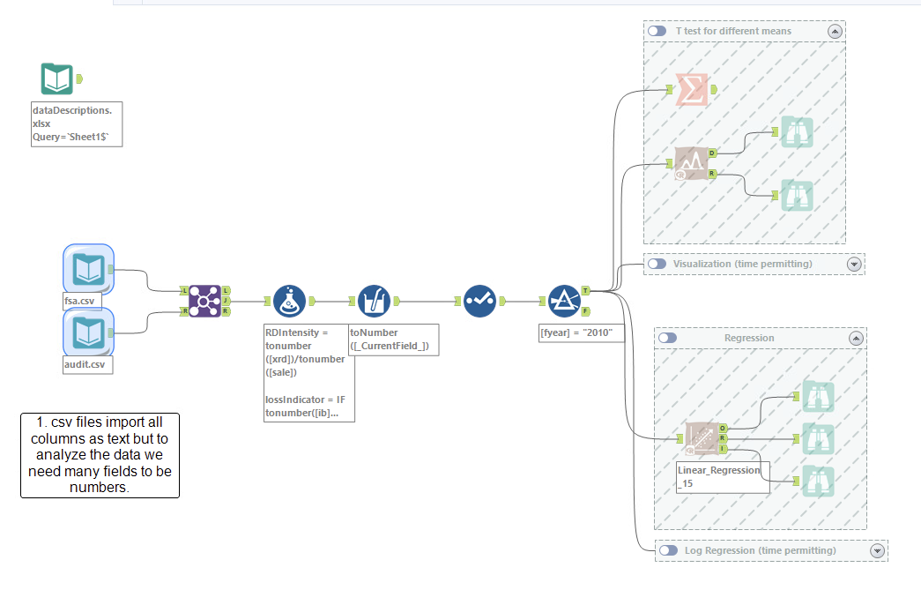

Slide 5
Agenda
Review
Audit Risk and Planning
Overview
Qualitative Exercise: Identify Risks & Classify Accounts
Materiality Discussion
Semi-Quantitative / Qualitative Assessments of Materiality
Dynamic Audit Planning Exercise

Slide 6
Audit Risk and Planning: Overview

Slide 7
Audit Risk Model
Audit Risk: risk that the auditor expresses an inappropriate audit opinion when the financial statements are materially misstated
AR = IR x CR x DR
RMM
Inherent Risk: risk that a management assertion is materially misstated (before considering internal controls)
Control Risk: risk that internal controls fail to detect a misstatement
Detection Risk: risk that auditors fail to detect a misstatement

Slide 8
Identifying Significant Accounts
AS 2110 – To identify significant accounts and disclosures and their relevant assertions, auditors should consider:
Size and composition of the account
Susceptibility to misstatement due to error or fraud
Volume of activity, complexity, and homogeneity of individual transactions
Nature of the account and disclosure
Accounting and reporting complexities
Exposure to losses
Possibility of significant contingent liabilities
Existence of related party transactions
Changes from prior period

Slide 9
Business Risk: Auditor’s Perspective
AS 2110 – during the planning phase of the engagement, auditors should obtain an understanding of the company and its environment, including:
The nature of the company
Objectives and strategies and related business risks that might reasonably be expected to result in risks of material misstatement
Relevant industry, regulatory, and other external factors
Selection and application of accounting principles and related disclosures
Measurement and analysis of financial performance

Slide 10
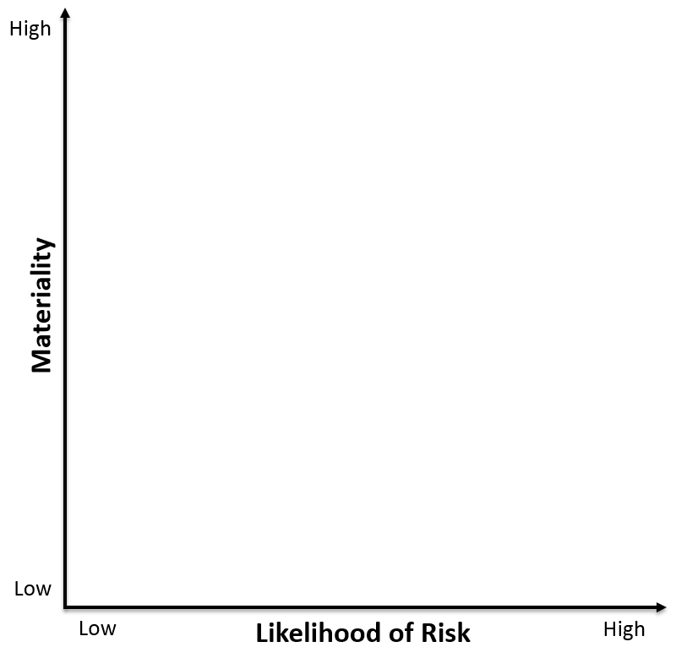
Misstatement Risk
Function of Materiality and Probability
2
1
3
4

Slide 11
Group Exercise – part 1
Applying the misstatement risk framework to the company selected by your group:
Prepare a brief 30-second overview of your company's business (nature, objectives, strategies) for the class.
Identify 1 account that falls into each of the 4 categories. Where does it fall within the quadrant, and why? In other words, assess the materiality and likelihood of risk associated with the account.
2
1
3
4

Slide 13
Required Risk Disclosures
Item 1a – Companies are required to disclose “the most significant factors that make an investment in a registrant’s securities speculative or risky”
Broad definition with little authoritative guidance
Examples provided by SEC (unchanged since 1964): lack of operating history, lack of profitability in recent periods, financial position, businesses or proposed businesses, lack of market in the company’s securities
Boilerplate or relevant information?
Listed in order of significance

Slide 14
Required Risk Disclosures
Critical Accounting Policies/Estimates (CAPs) – companies should consider whether they have made accounting estimates or assumptions where:
Nature of estimates/assumptions is material due to levels of subjectivity, judgment, and uncertainty
The impact of the estimates and assumptions is material
If so, the company should disclose in CAPs section of MD&A

Slide 15
Group Exercise – part 1
Applying the misstatement risk framework to the company selected by your group:
Prepare a brief 30-second overview of your company's business (nature, objectives, strategies) for the class.
Identify 1 account that falls into each of the 4 categories. Where does it fall within the quadrant, and why? In other words, assess the materiality and likelihood of risk associated with the account.
2
1
3
4

Slide 16
Agenda
Review
Audit Risk and Planning
Overview
Qualitative Exercise: Identify Risks & Classify Accounts
Materiality Discussion
Assessments of Materiality and Dynamic Audit Planning Exercise

Slide 17
Materiality

Slide 18
What is Materiality?
AS 2105.03: "… the auditor should plan and perform audit procedures to detect misstatements that, individually or in combination with other misstatements, would result in material misstatement of the financial statements."
SAB 99: "a fact is material if there is a substantial likelihood that the … fact would have been viewed by the reasonable investor as having significantly altered the 'total mix' of the information made available."
i.e., Influences the economic decisions of users
How do we translate this to numbers?

Slide 19
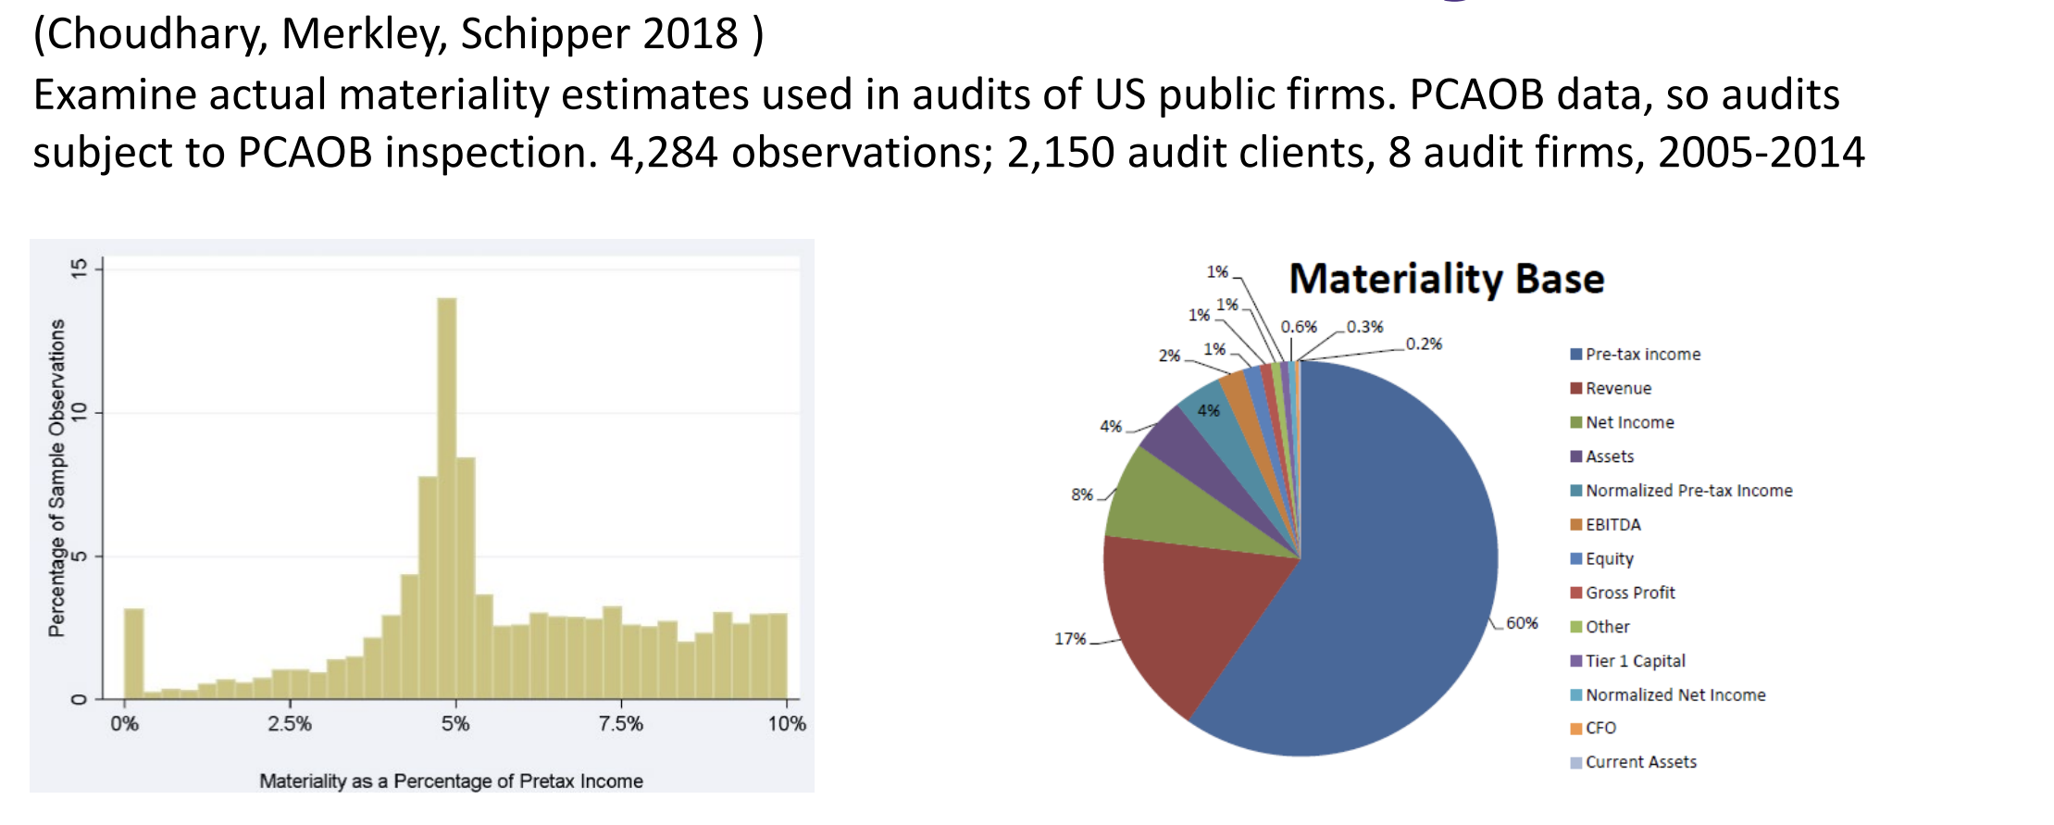
What the data suggests:

Slide 20
Agenda
Review
Audit Risk and Planning
Overview
Qualitative Exercise: Identify Risks & Classify Accounts
Materiality Discussion
Assessments of Materiality and Dynamic Audit Planning Exercise

Slide 21
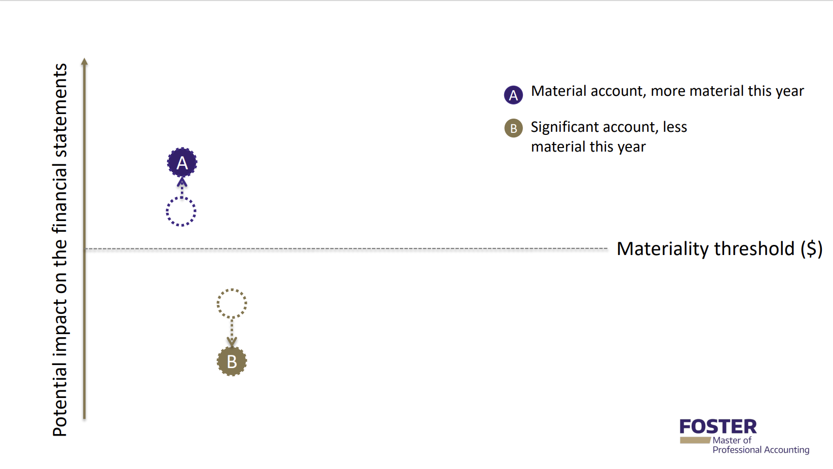
Group Exercise – part 2
Remind the class of your company.
Identify 3 material accounts that you can provide reasons for a potential change in risk, either becoming more material or more risky (e.g., C). Explain why for each account.
C

Slide 22
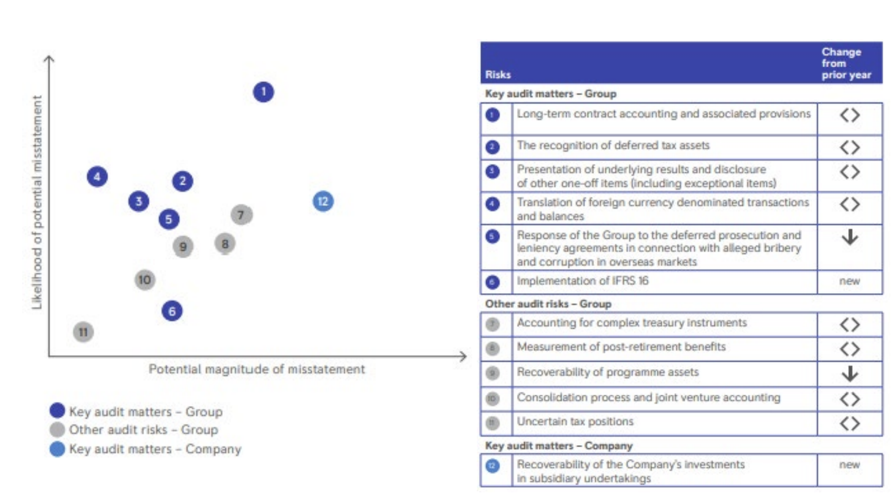
Dynamic Audit Planning - Viz

Slide 23
You can use any tool, either powerpoint or something like LuidChart (free – login with Google)
https://lucid.app/lucidchart/e75991e8-da6e-4677-a99e-03b270f61b8a/edit?viewport_loc=-11%2C-11%2C4235%2C1571%2C0_0&invitationId=inv_1d94e63f-ab4e-45d3-afd9-5ded49aace08

Slide 24
Group Exercise – part 2
Remind the class of your company.
Identify 3 material accounts that you can provide reasons for a potential change in risk, either becoming more material or more risky (e.g., C). Explain why for each account.
C

Slide 25
THANK YOU

